Slide 1


Slide 2
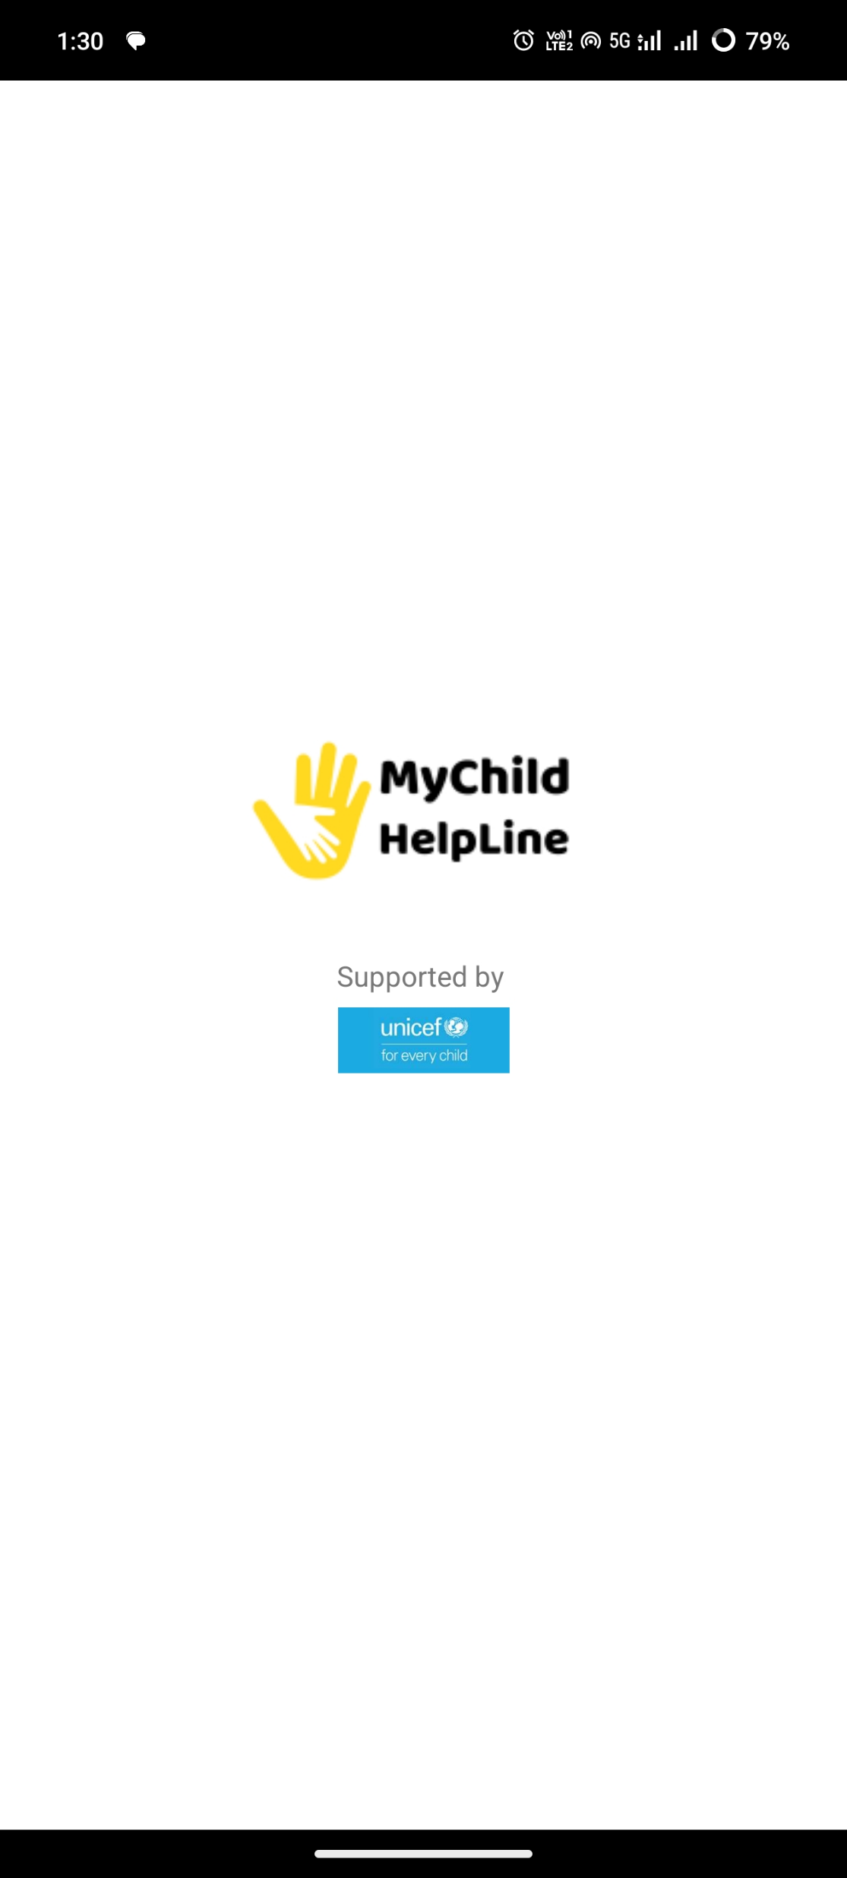
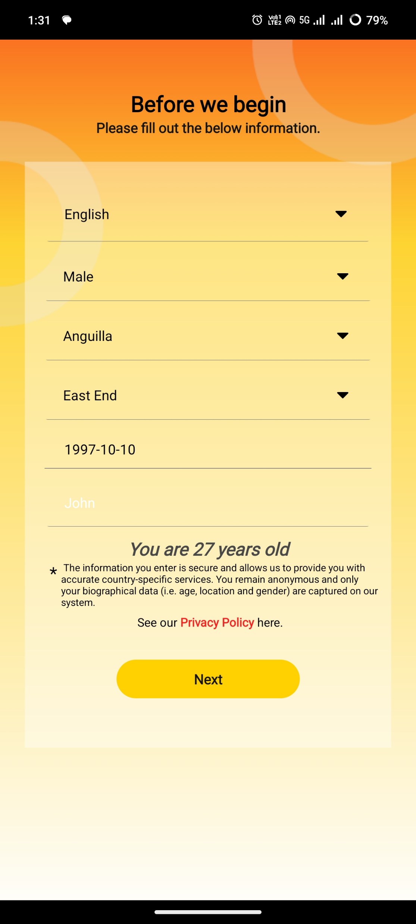
Home Page Enter the Login details
Homepage
Data Analysis
Fill in the necessary data :
Language
Gender
Location
District
Date of Birth
Name
Click Next to register

Slide 3
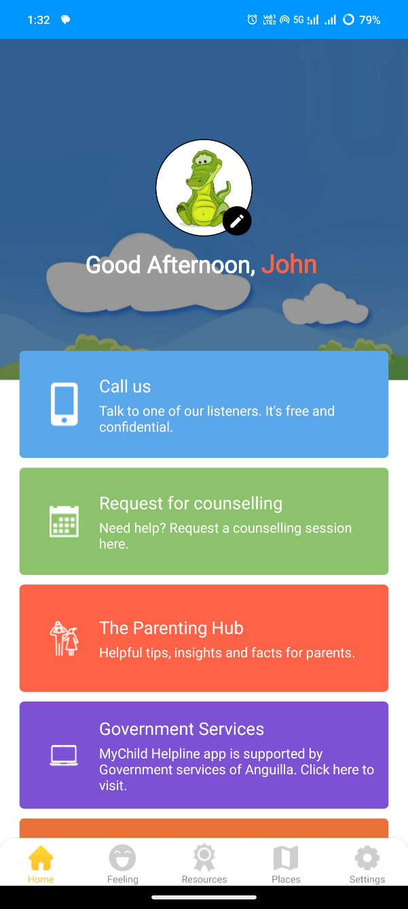
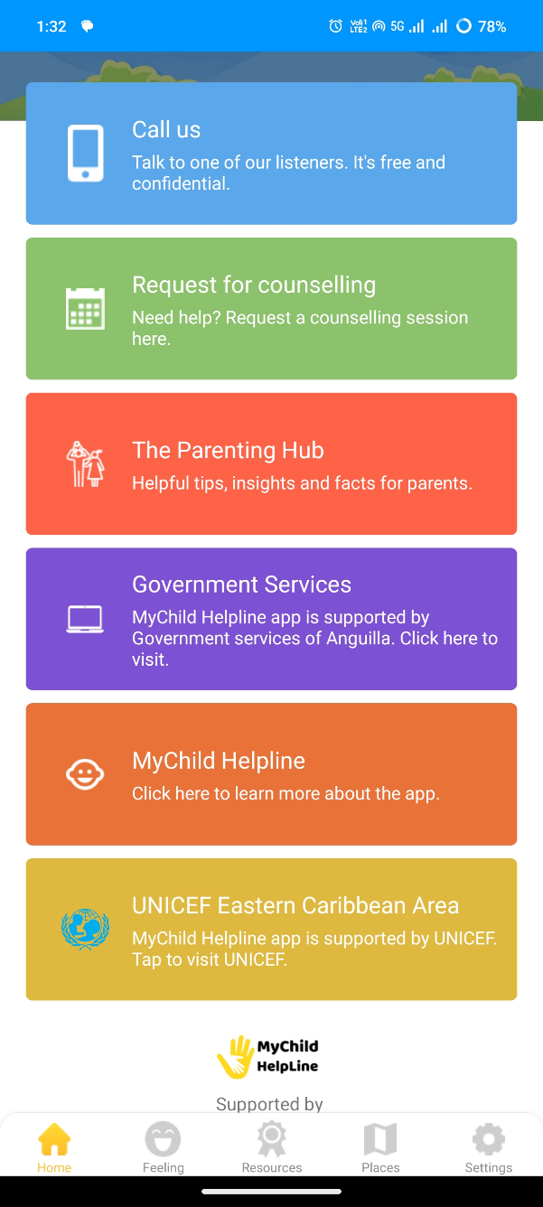
Landing Page Services Menu
Homepage
Data Analysis
Select From various services:
Call Us
Request for counselling
The Parenting Hub
Government Services
MyChild Helpline
UNICEF Easter Caribbean Area

Slide 4
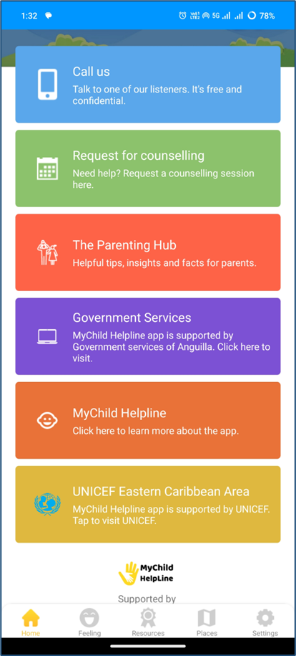
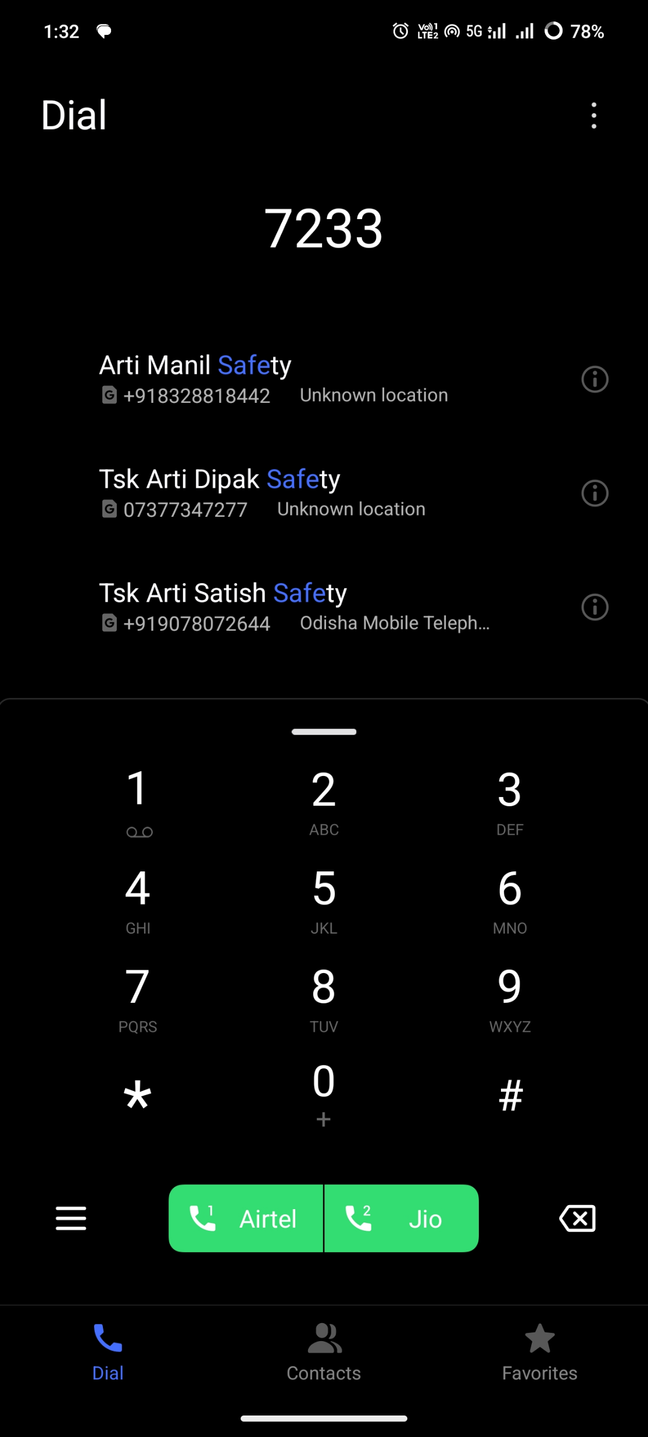


Call us Click on Call Us to Talk to Listerners
Login

Slide 5
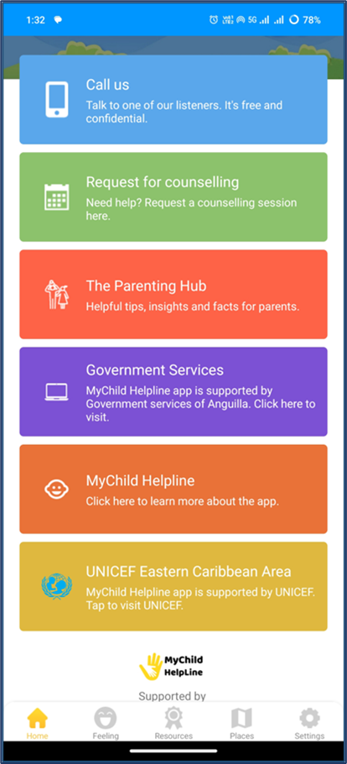
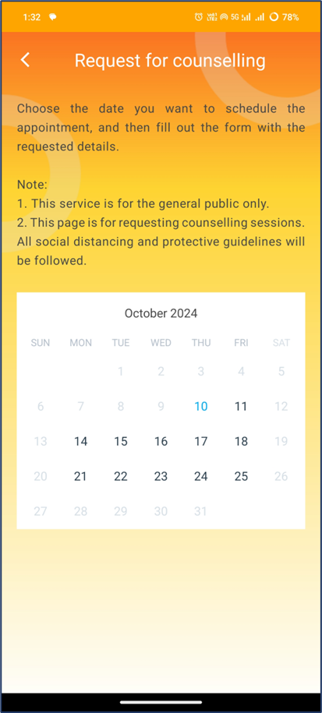
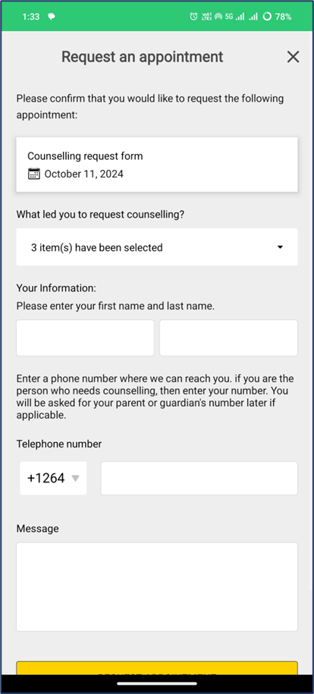
Request for Counseling Select Counseling date and fill details in the request form
Data Collect – Get Forms
List of Forms
Form Download
Select the counseling request date

Slide 6
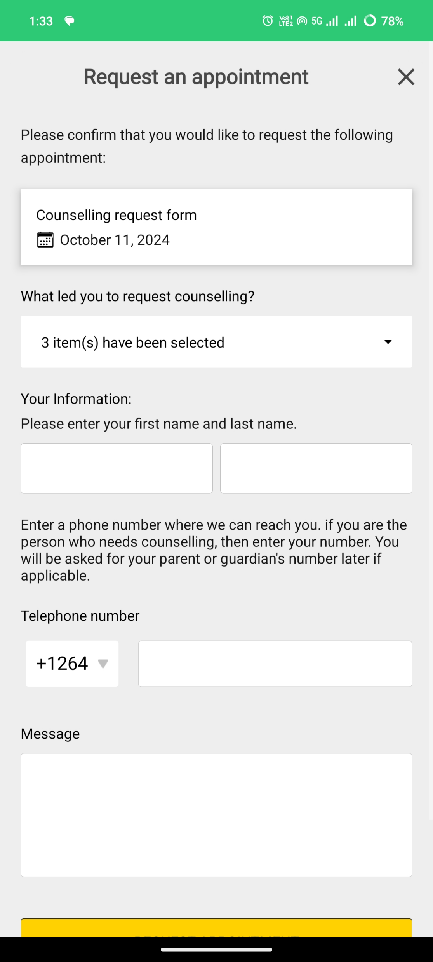
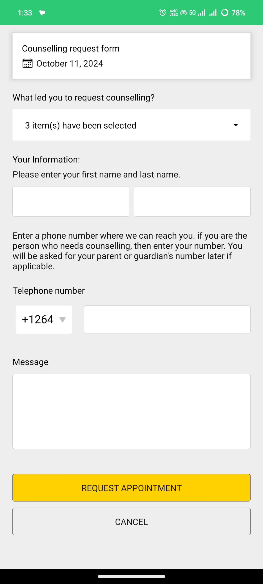
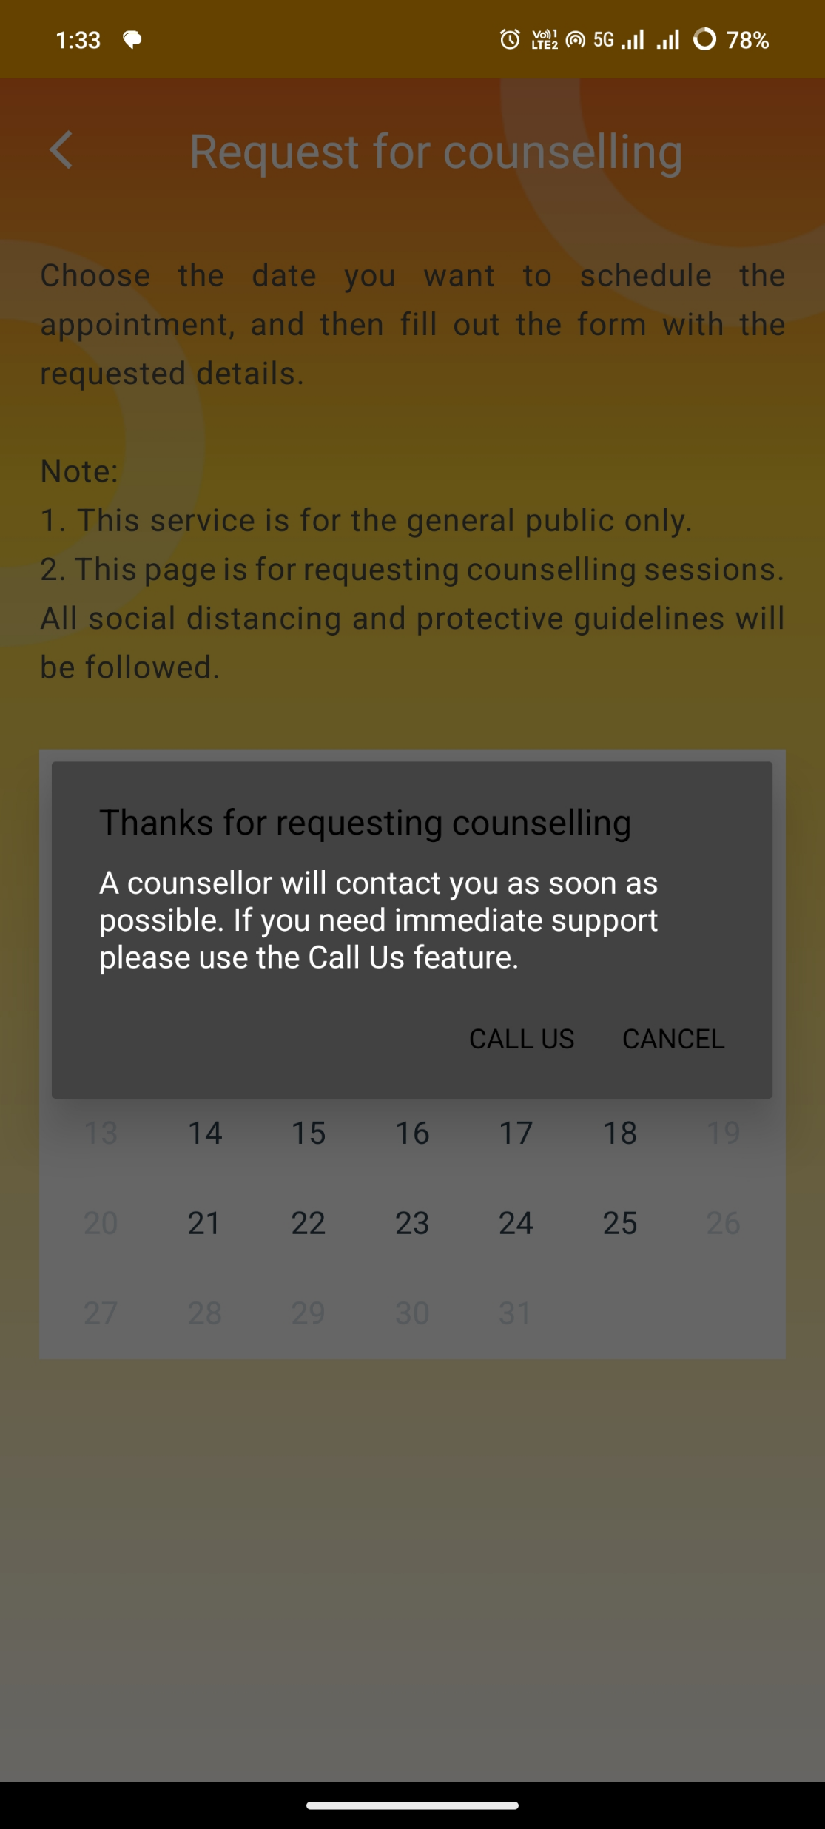
Home Page Complete the Request Form
Data Collect – Fill Forms
List of Forms
Form Details
Fill your details in the form
Click here to Submit the form
Successfully Submit Pop-up

Slide 7

Call us Click on Parenting Hub which directs to the UNICEF Parenting Web Page
Login

Slide 8
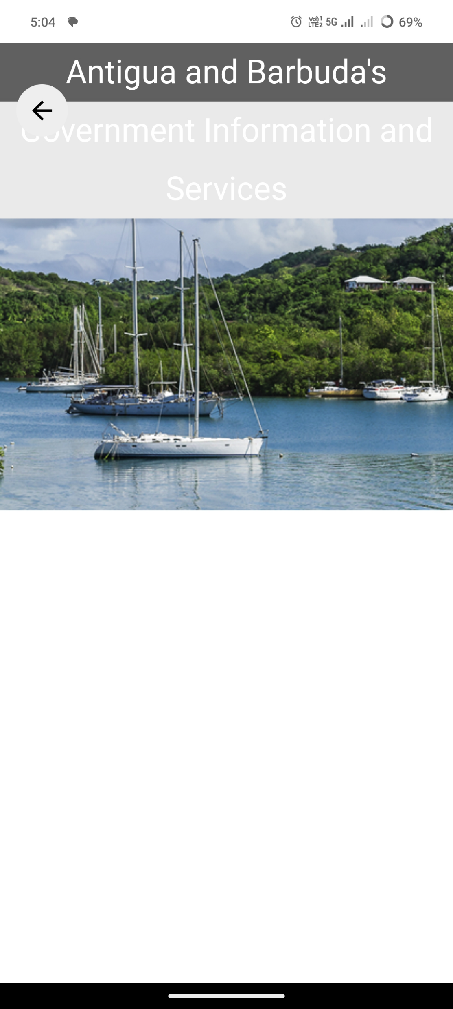
Call us Click on Parenting Hub which directs to the Antigua and Barbuda’s GIS webpage
Login

Slide 9
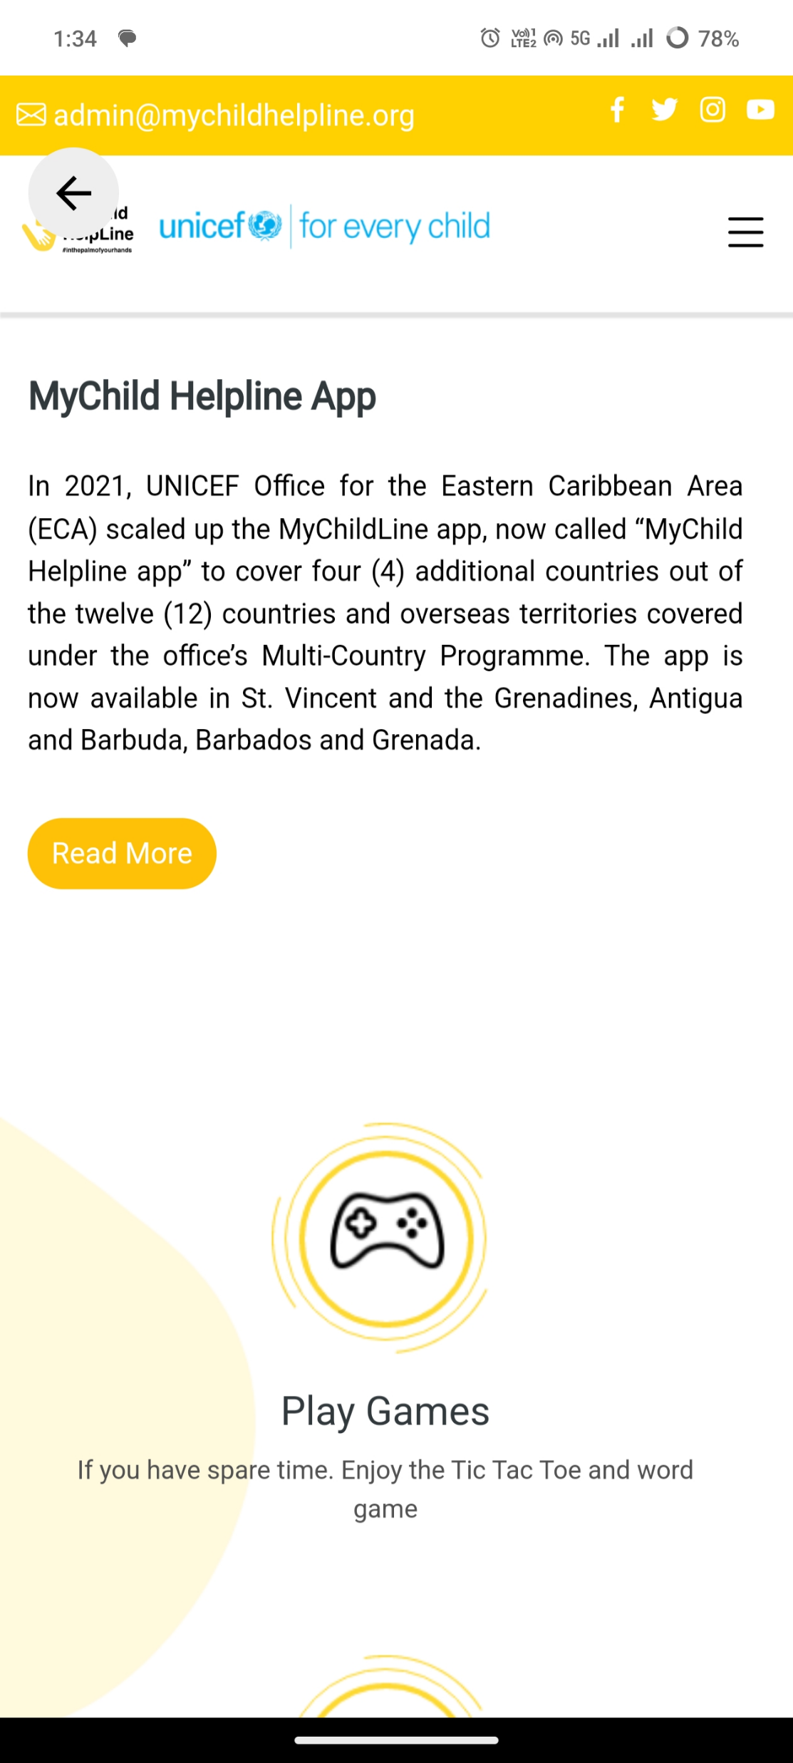
Call us Click on Parenting Hub which directs to the UNICEF Parenting Web Page
Login

Slide 10

Call us Click on Parenting Hub which directs to the UNICEF Parenting Web Page
Login

Slide 11
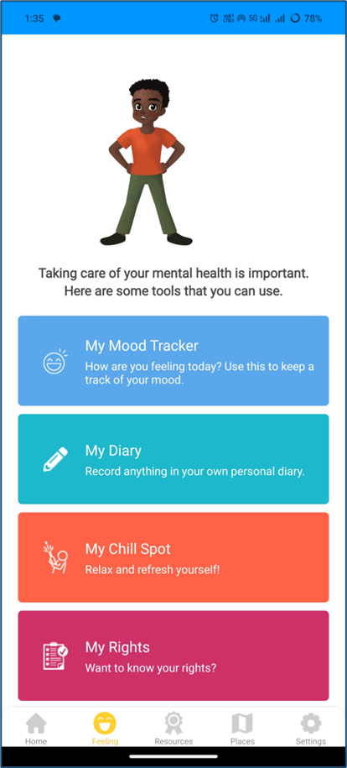
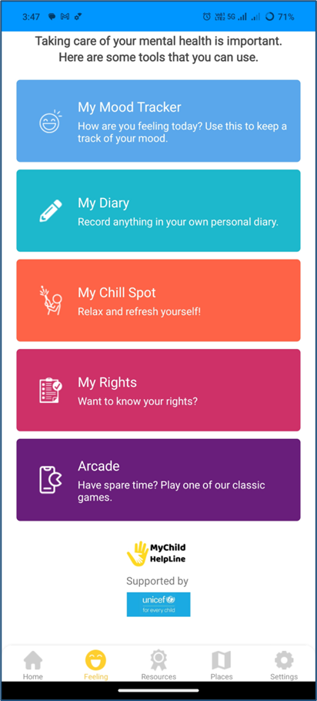
Home Page Enter the Login details
Homepage
Data Analysis
Click here to filter data by Disaster Type
Click here to navigate to the Data Analysis module
Perform following actions using the map toolbar:
Zoom-in
Zoom-out
Reset
Label on/off
North symbol show/hide
Click here to change the Visualization Type

Slide 12
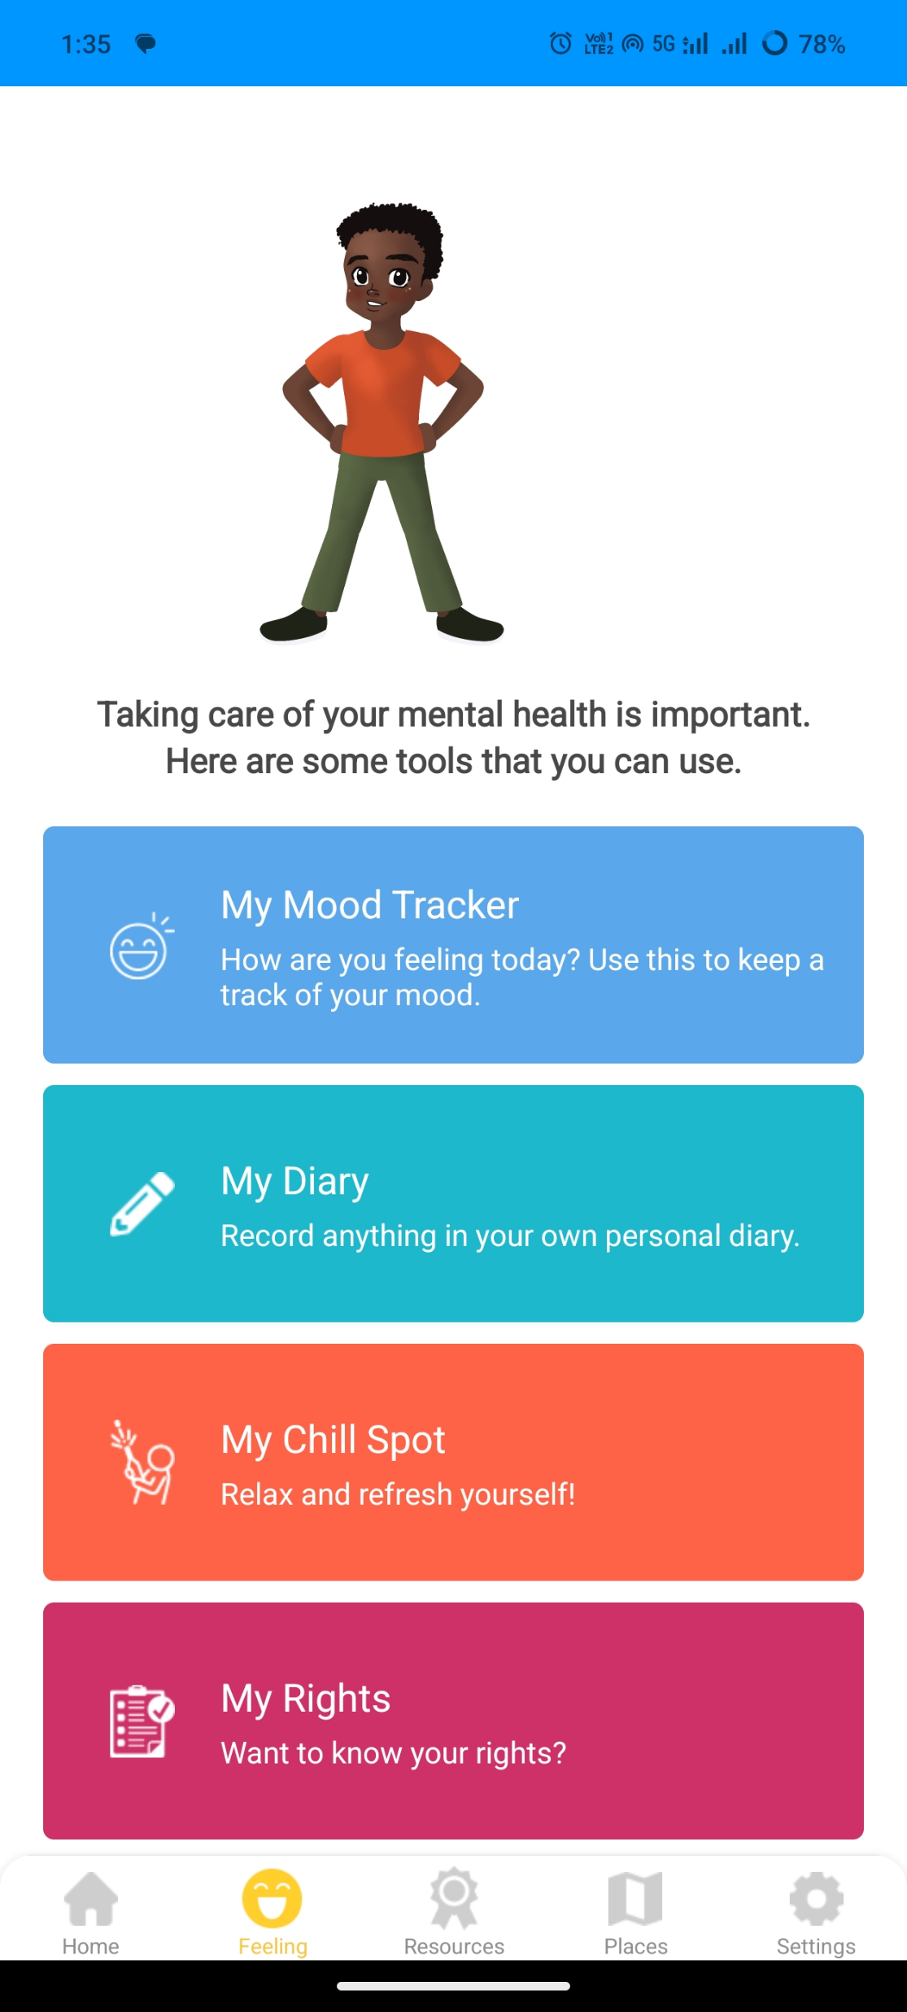
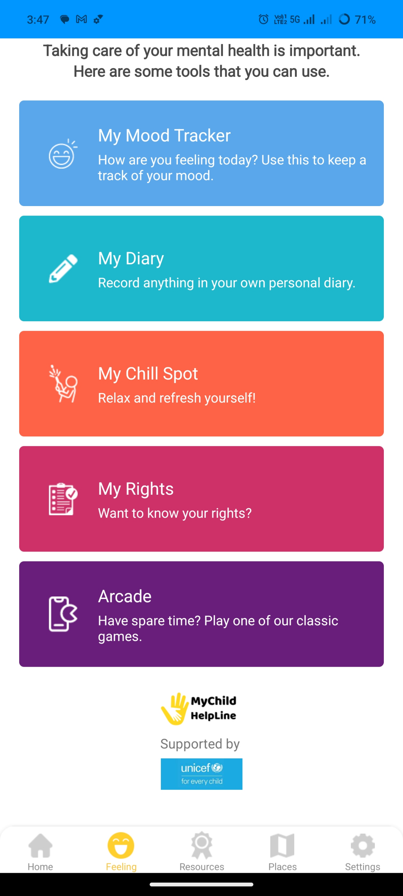
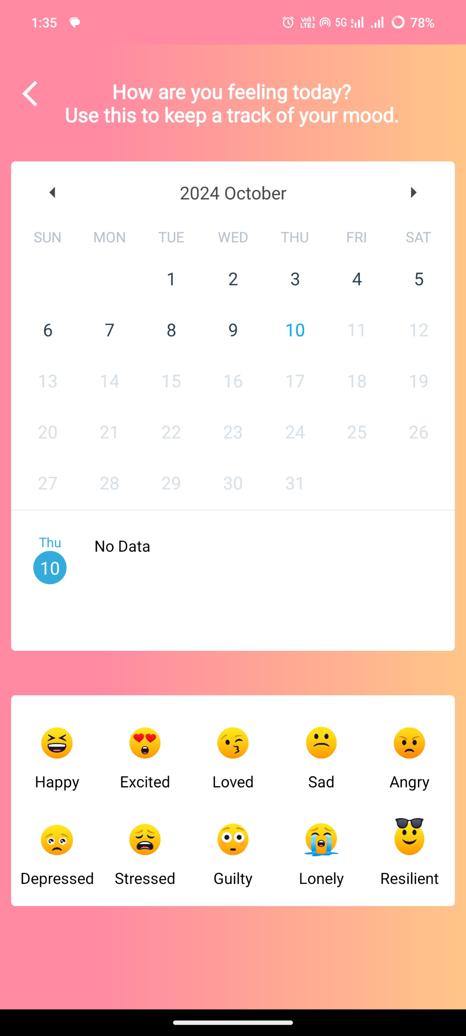
Home Page Enter the Login details
Edit, Finalized and Sent forms
Finalized Forms
Sent Forms
Click here to Submit or Delete the Finalized form respectively
Click here to Delete the sent form
Click here to Edit the saved forms
Click here to view the Finalized forms
Click here to view the Sent forms

Slide 13
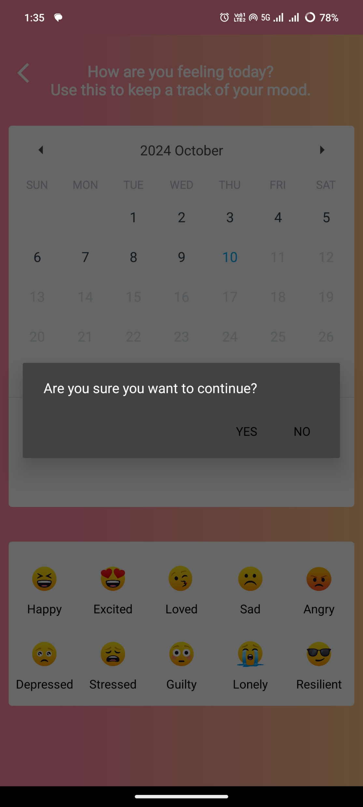
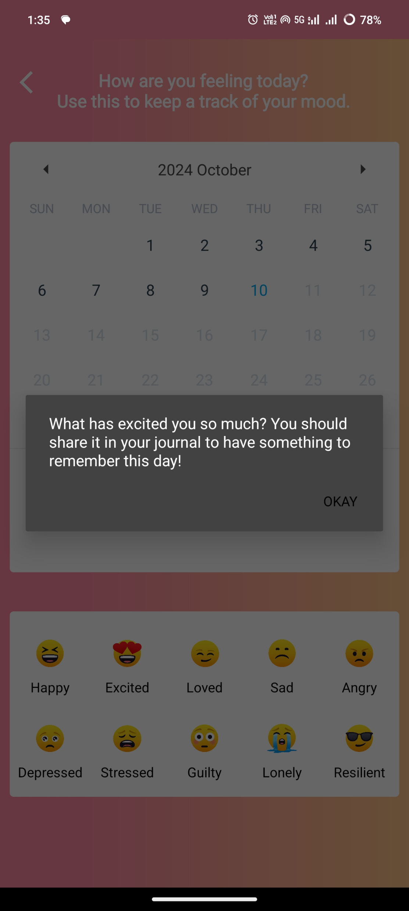
Home Page Enter the Login details
Edit, Finalized and Sent forms
Finalized Forms
Sent Forms
Click here to Submit or Delete the Finalized form respectively
Click here to Delete the sent form
Click here to Edit the saved forms
Click here to view the Finalized forms
Click here to view the Sent forms

Slide 14
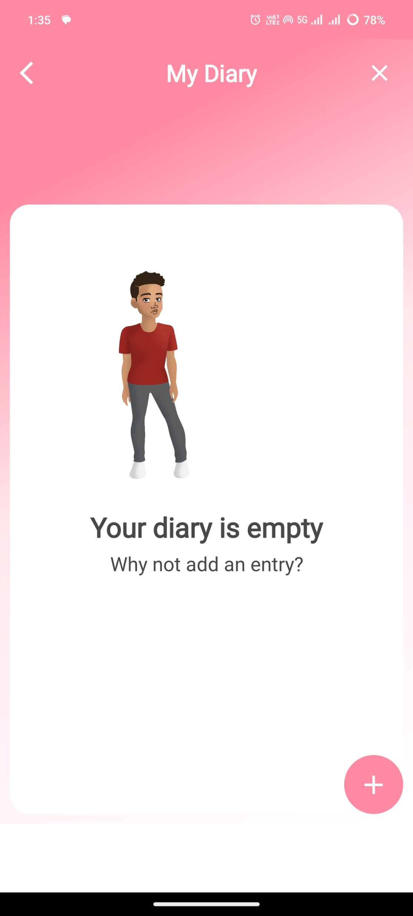
Home Page Enter the Login details
Edit, Finalized and Sent forms
Finalized Forms
Sent Forms
Click here to Submit or Delete the Finalized form respectively
Click here to Delete the sent form
Click here to Edit the saved forms
Click here to view the Finalized forms
Click here to view the Sent forms

Slide 15
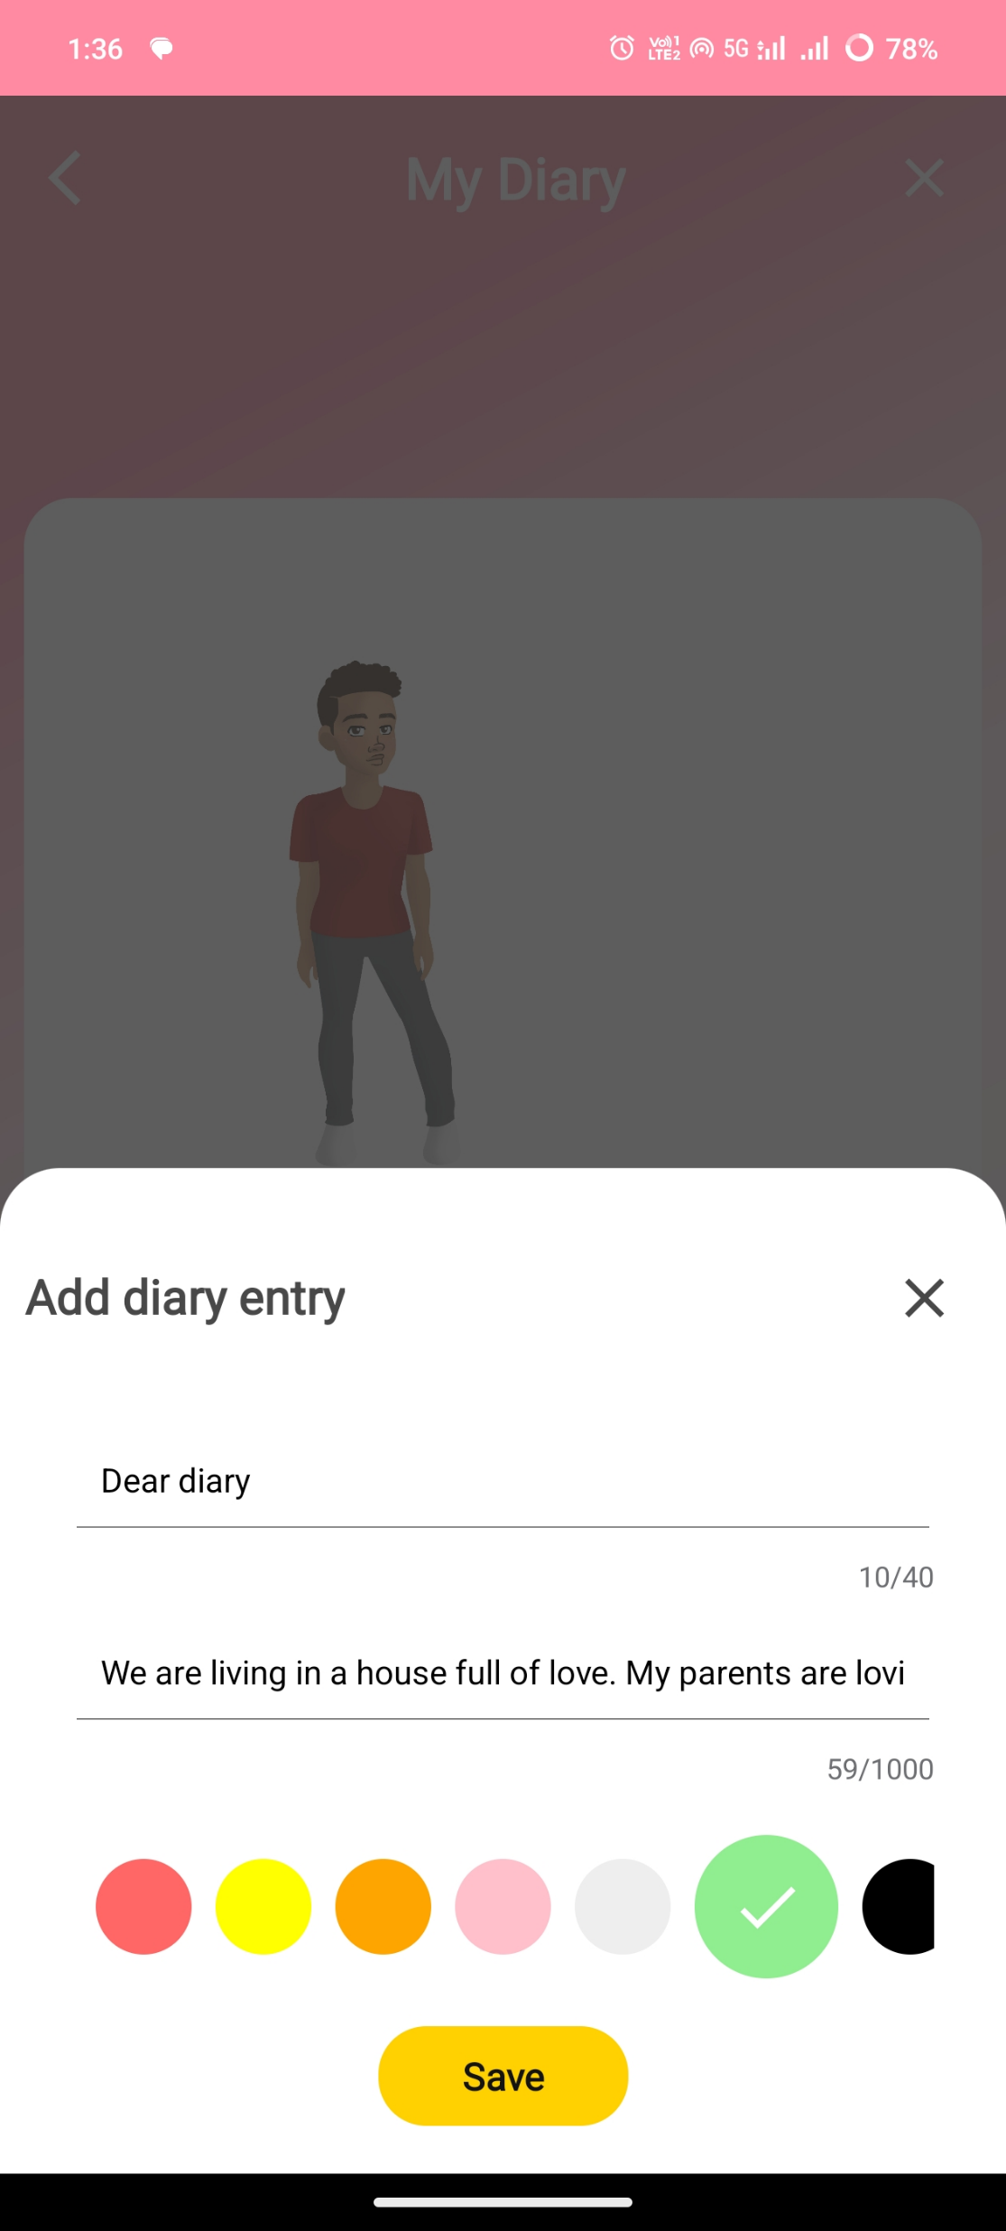
Home Page Enter the Login details
Edit, Finalized and Sent forms
Finalized Forms
Sent Forms
Click here to Submit or Delete the Finalized form respectively
Click here to Delete the sent form
Click here to Edit the saved forms
Click here to view the Finalized forms
Click here to view the Sent forms

Slide 16
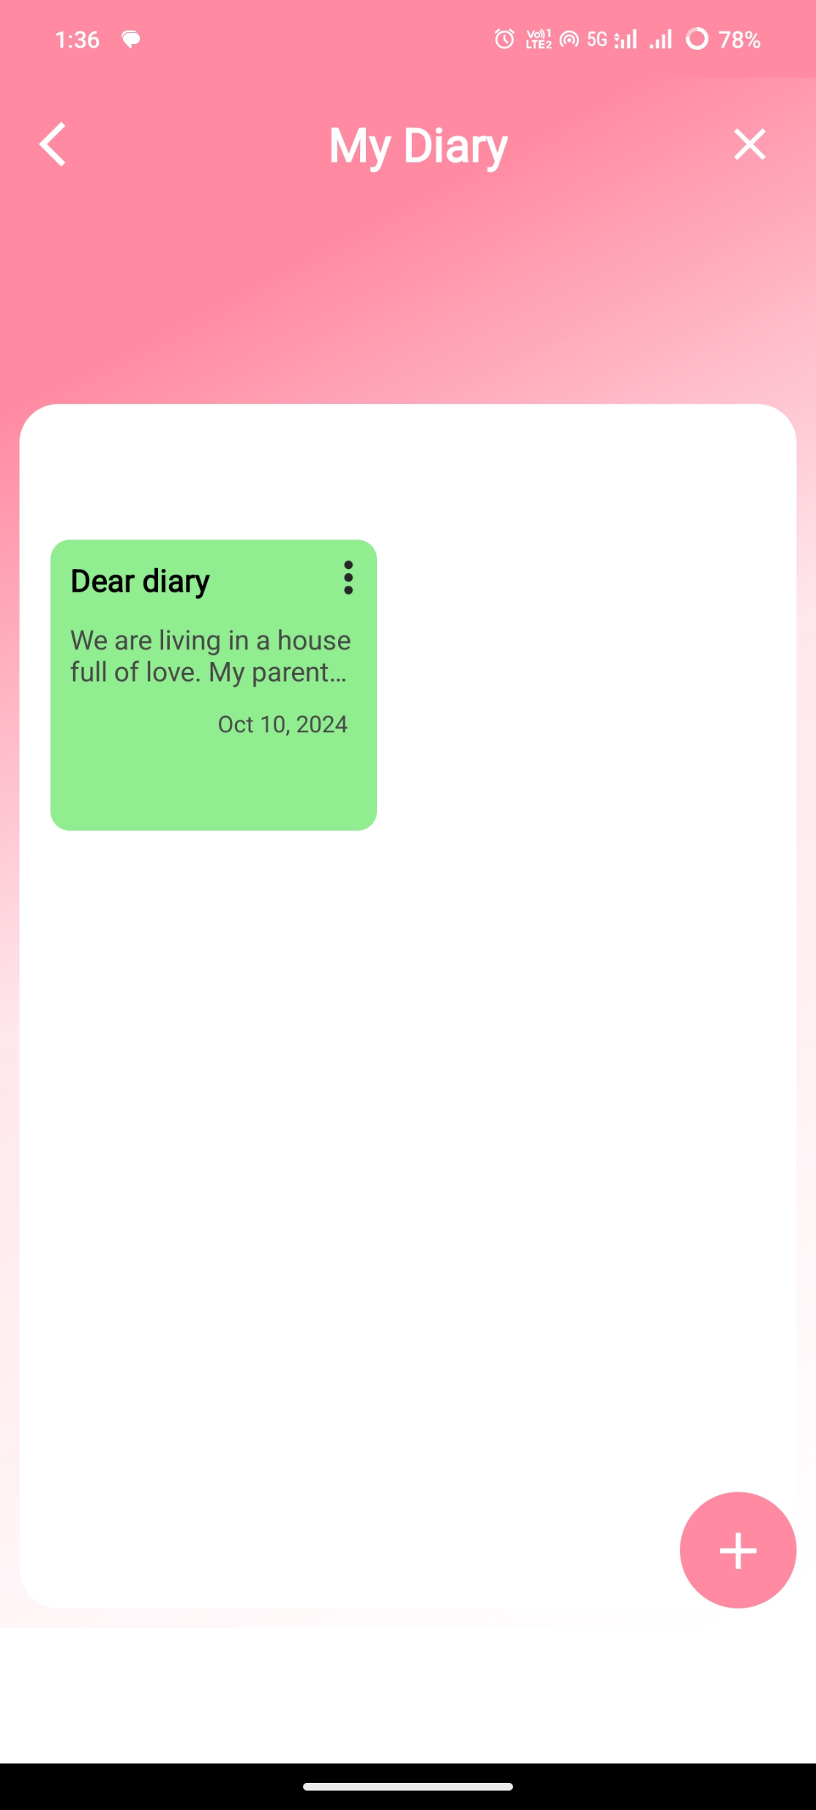
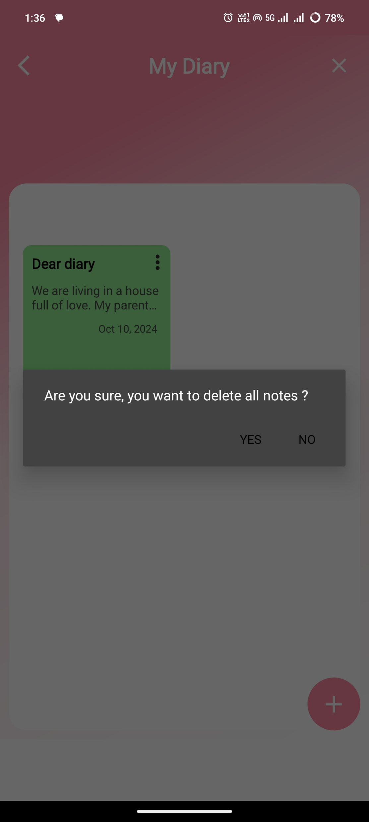
Home Page Enter the Login details
Edit, Finalized and Sent forms
Finalized Forms
Sent Forms
Click here to Submit or Delete the Finalized form respectively
Click here to Delete the sent form
Click here to Edit the saved forms
Click here to view the Finalized forms
Click here to view the Sent forms

Slide 17
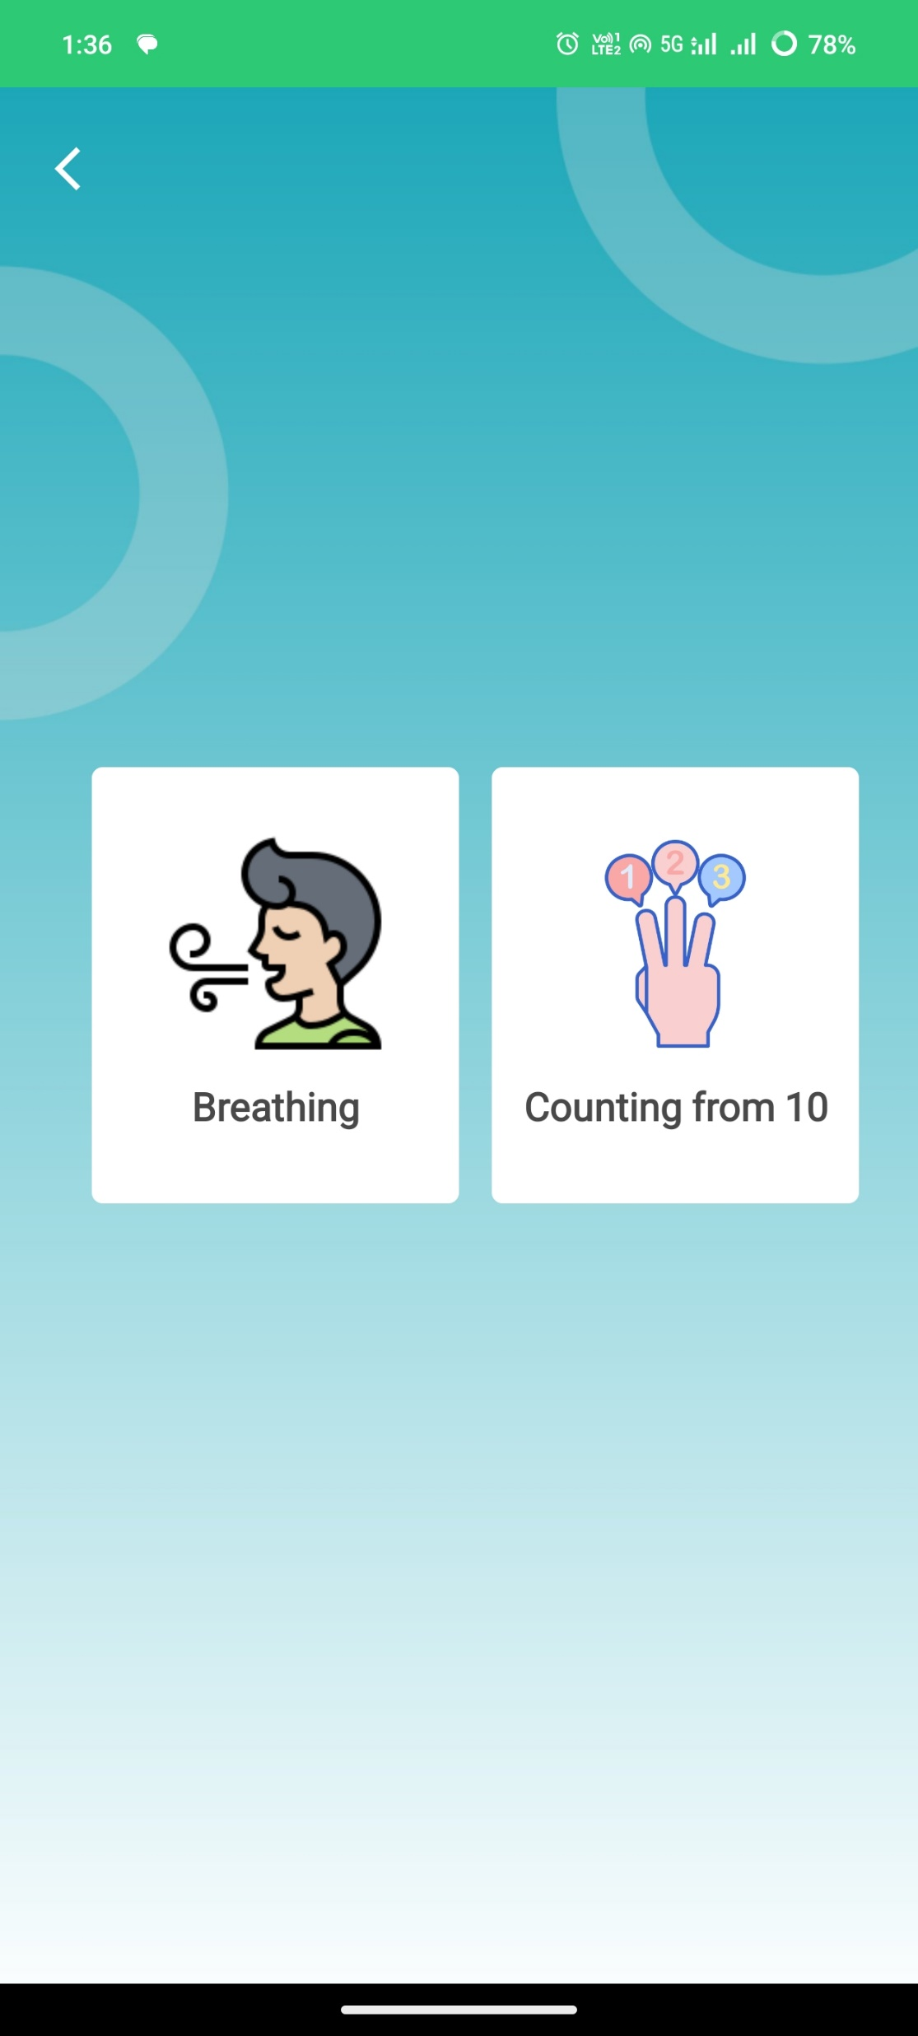
Home Page Enter the Login details
Edit, Finalized and Sent forms
Finalized Forms
Sent Forms
Click here to Submit or Delete the Finalized form respectively
Click here to Delete the sent form
Click here to Edit the saved forms
Click here to view the Finalized forms
Click here to view the Sent forms

Slide 18
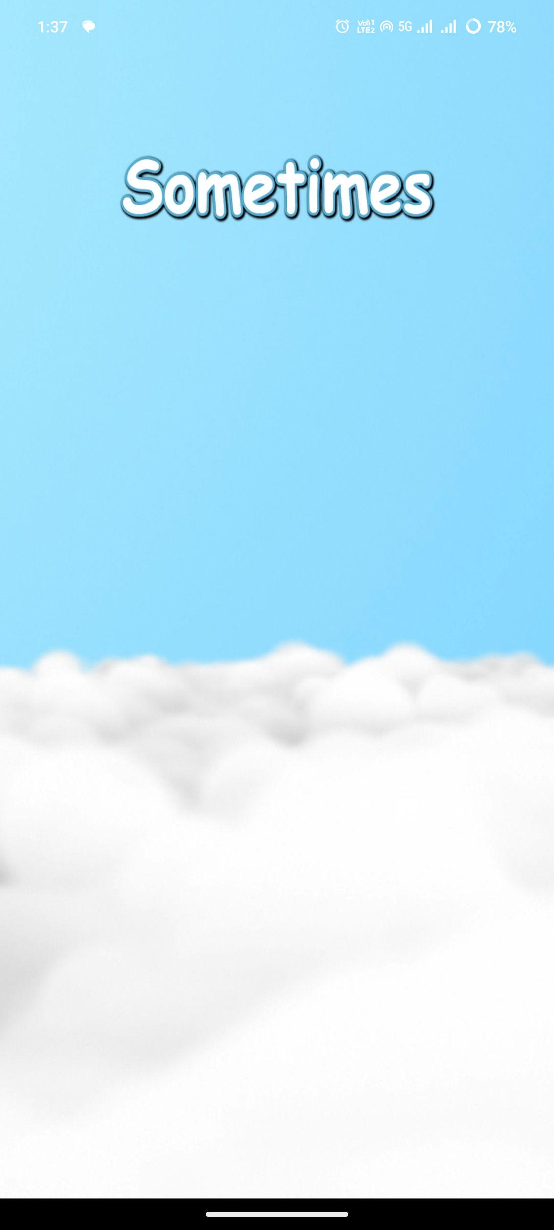


Home Page Enter the Login details
Edit, Finalized and Sent forms
Finalized Forms
Sent Forms
Click here to Submit or Delete the Finalized form respectively
Click here to Delete the sent form
Click here to Edit the saved forms
Click here to view the Finalized forms
Click here to view the Sent forms

Slide 19
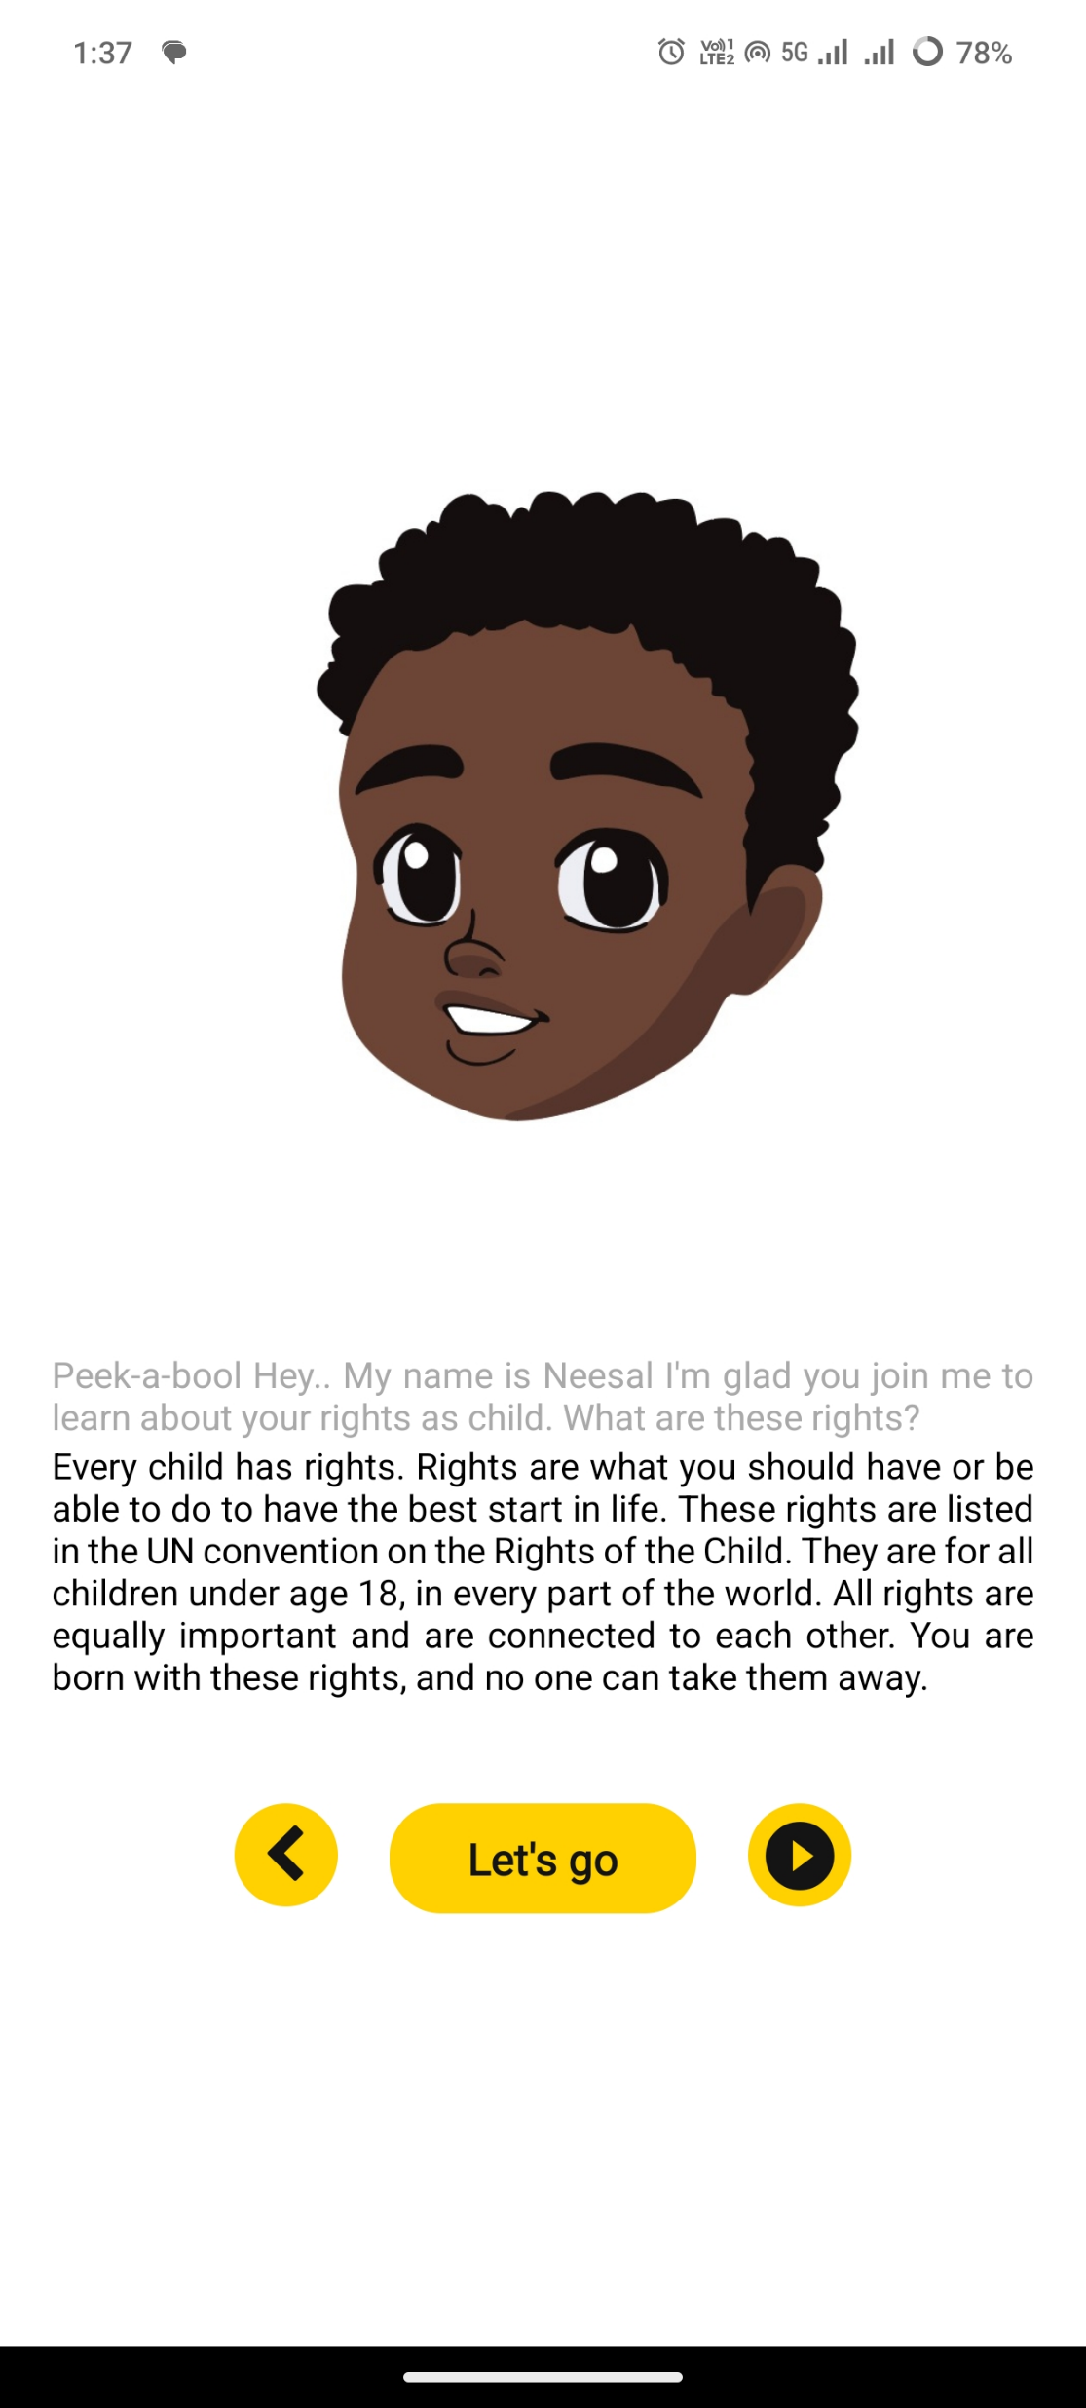
Home Page Enter the Login details
Edit, Finalized and Sent forms
Finalized Forms
Sent Forms
Click here to Submit or Delete the Finalized form respectively
Click here to Delete the sent form
Click here to Edit the saved forms
Click here to view the Finalized forms
Click here to view the Sent forms

Slide 20
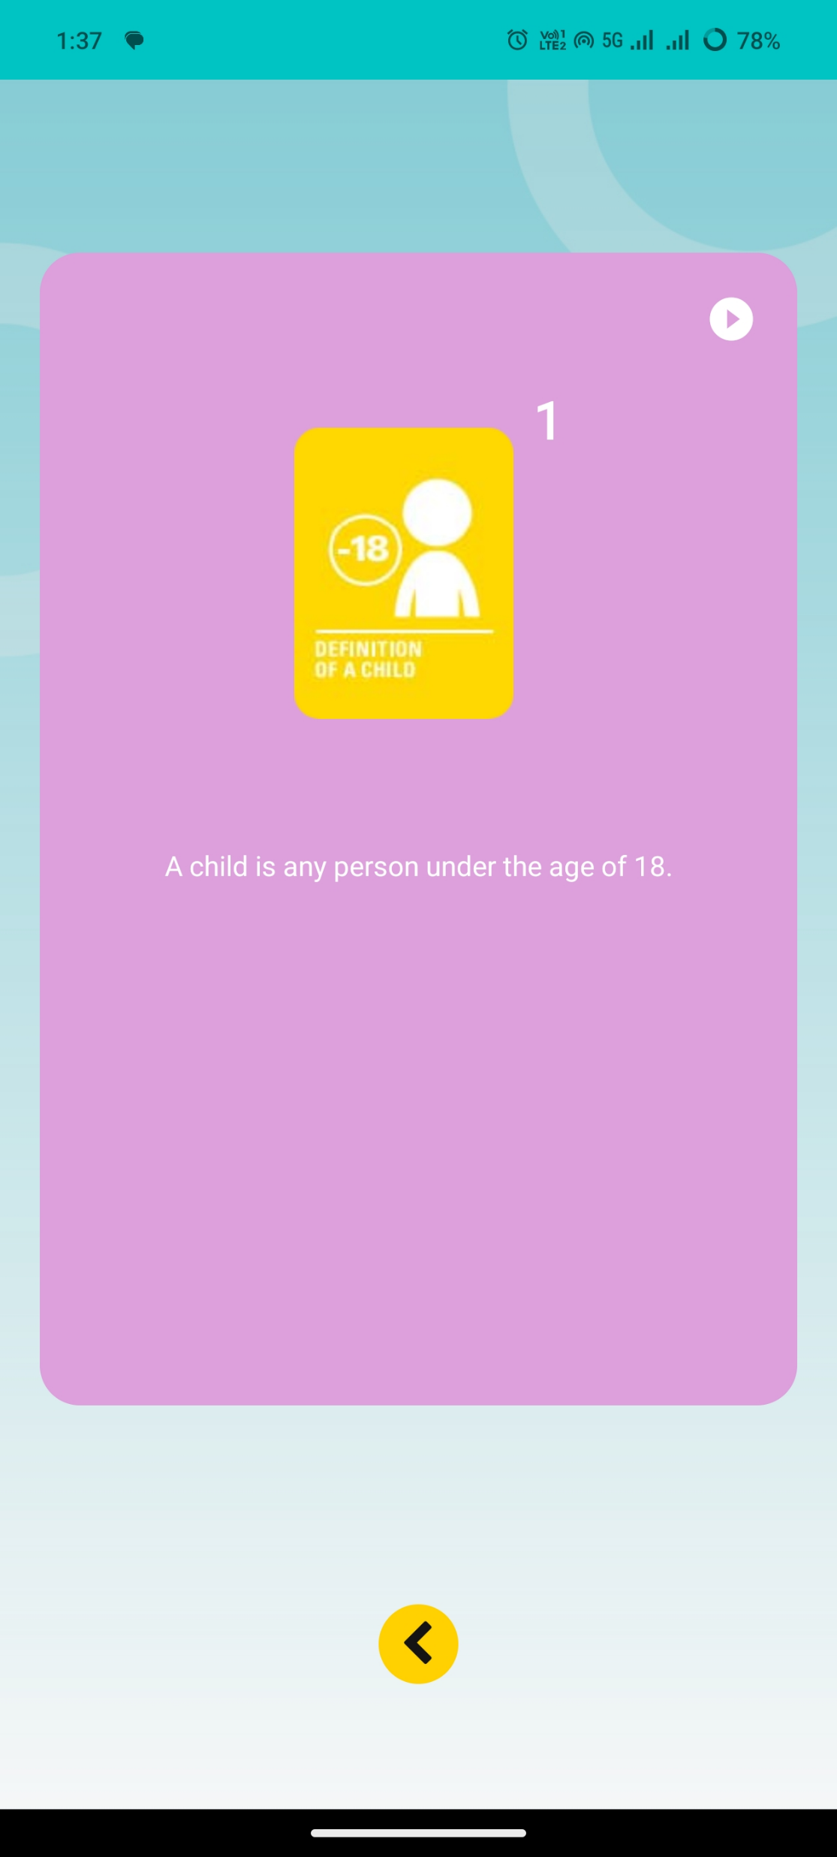
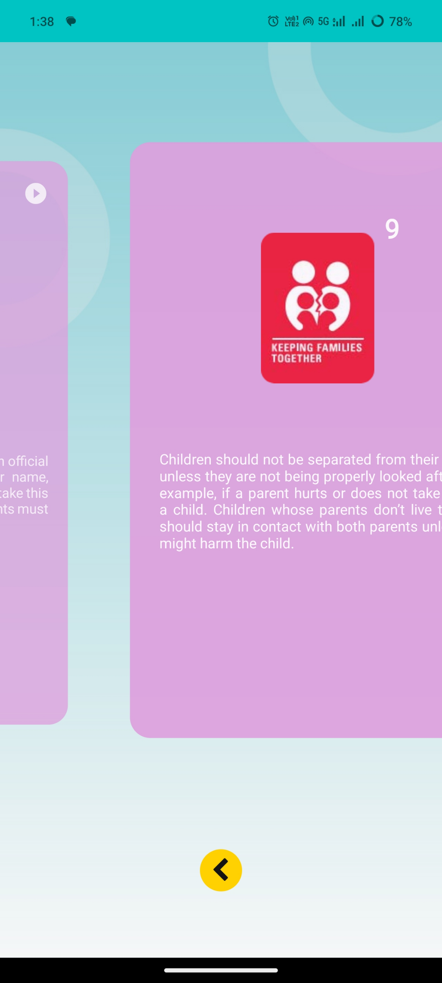
Home Page Enter the Login details
Edit, Finalized and Sent forms
Finalized Forms
Sent Forms
Click here to Submit or Delete the Finalized form respectively
Click here to Delete the sent form
Click here to Edit the saved forms
Click here to view the Finalized forms
Click here to view the Sent forms

Slide 21
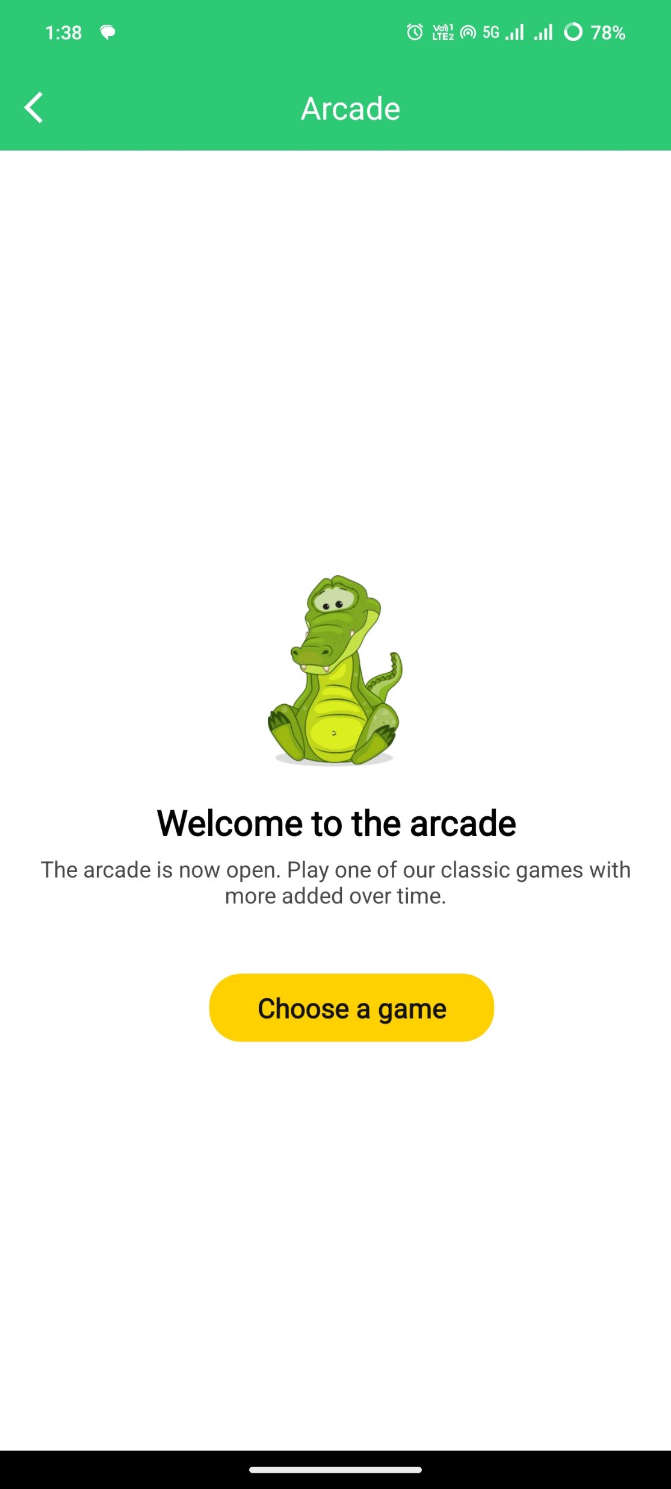
Home Page Enter the Login details
Edit, Finalized and Sent forms
Finalized Forms
Sent Forms
Click here to Submit or Delete the Finalized form respectively
Click here to Delete the sent form
Click here to Edit the saved forms
Click here to view the Finalized forms
Click here to view the Sent forms

Slide 22
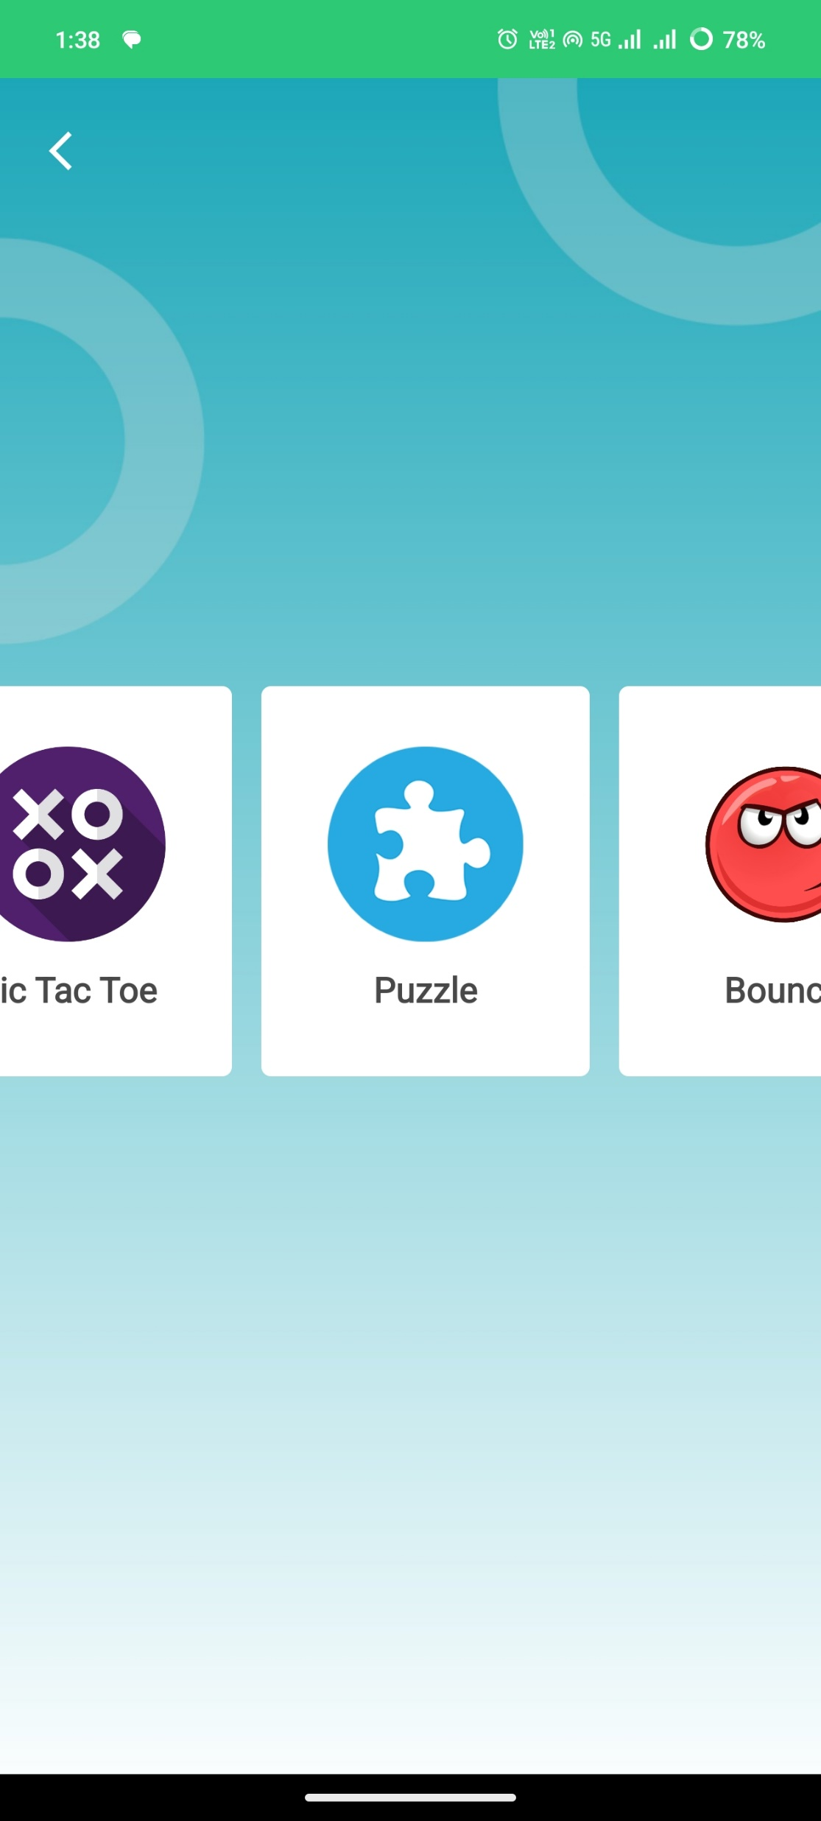
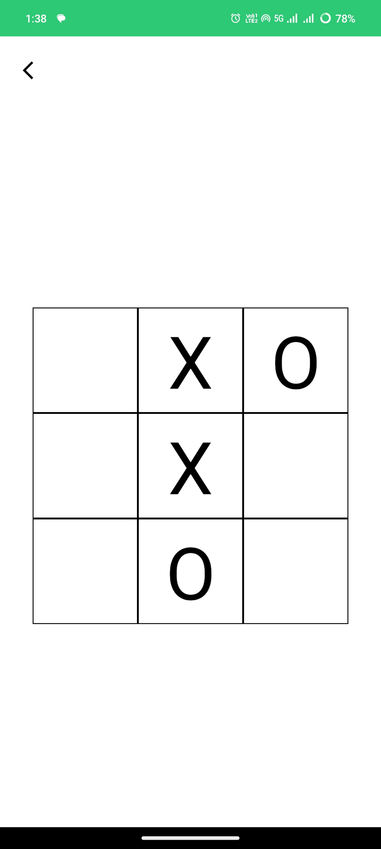
Home Page Enter the Login details
Edit, Finalized and Sent forms
Finalized Forms
Sent Forms
Click here to Submit or Delete the Finalized form respectively
Click here to Delete the sent form
Click here to Edit the saved forms
Click here to view the Finalized forms
Click here to view the Sent forms

Slide 23
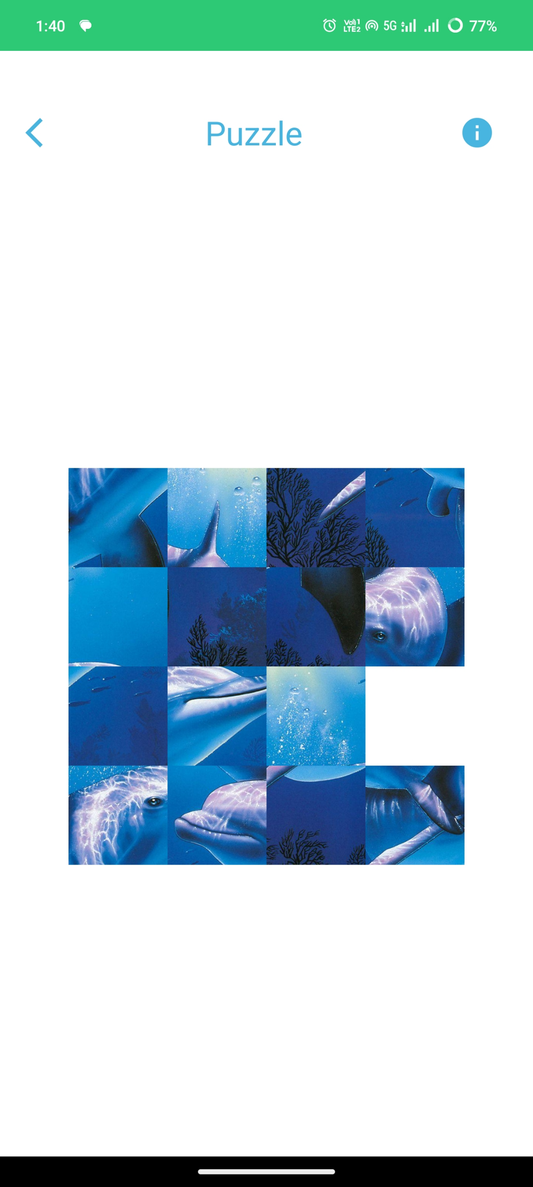
Home Page Enter the Login details
Edit, Finalized and Sent forms
Finalized Forms
Sent Forms
Click here to Submit or Delete the Finalized form respectively
Click here to Delete the sent form
Click here to Edit the saved forms
Click here to view the Finalized forms
Click here to view the Sent forms

Slide 24
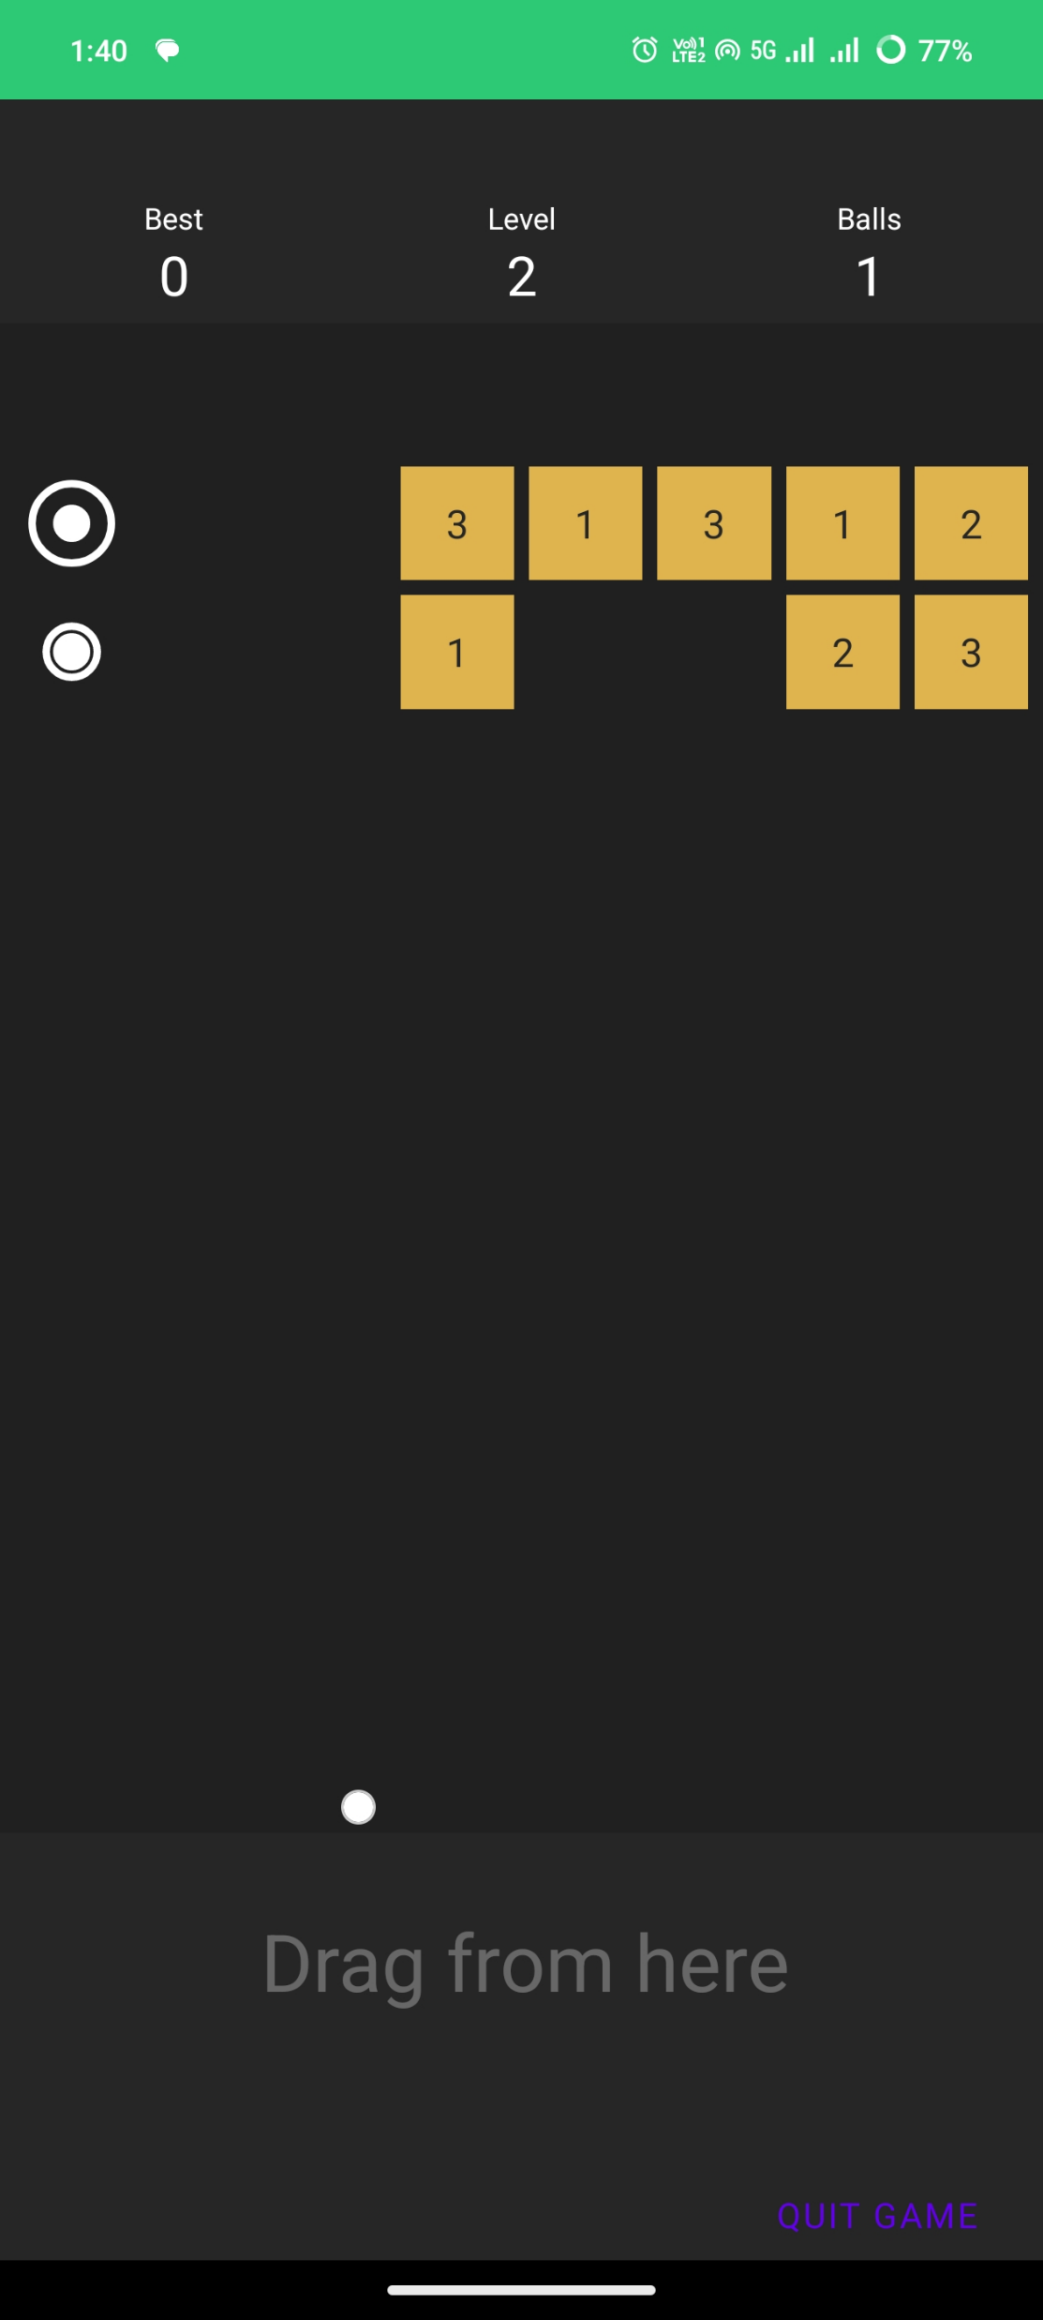
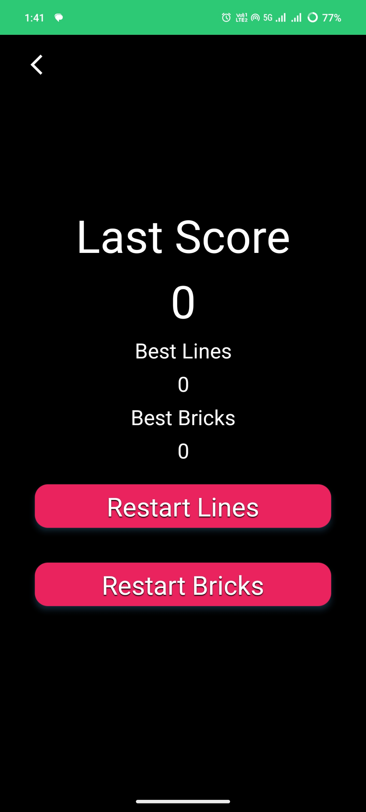
Home Page Enter the Login details
Edit, Finalized and Sent forms
Finalized Forms
Sent Forms
Click here to Submit or Delete the Finalized form respectively
Click here to Delete the sent form
Click here to Edit the saved forms
Click here to view the Finalized forms
Click here to view the Sent forms

Slide 25
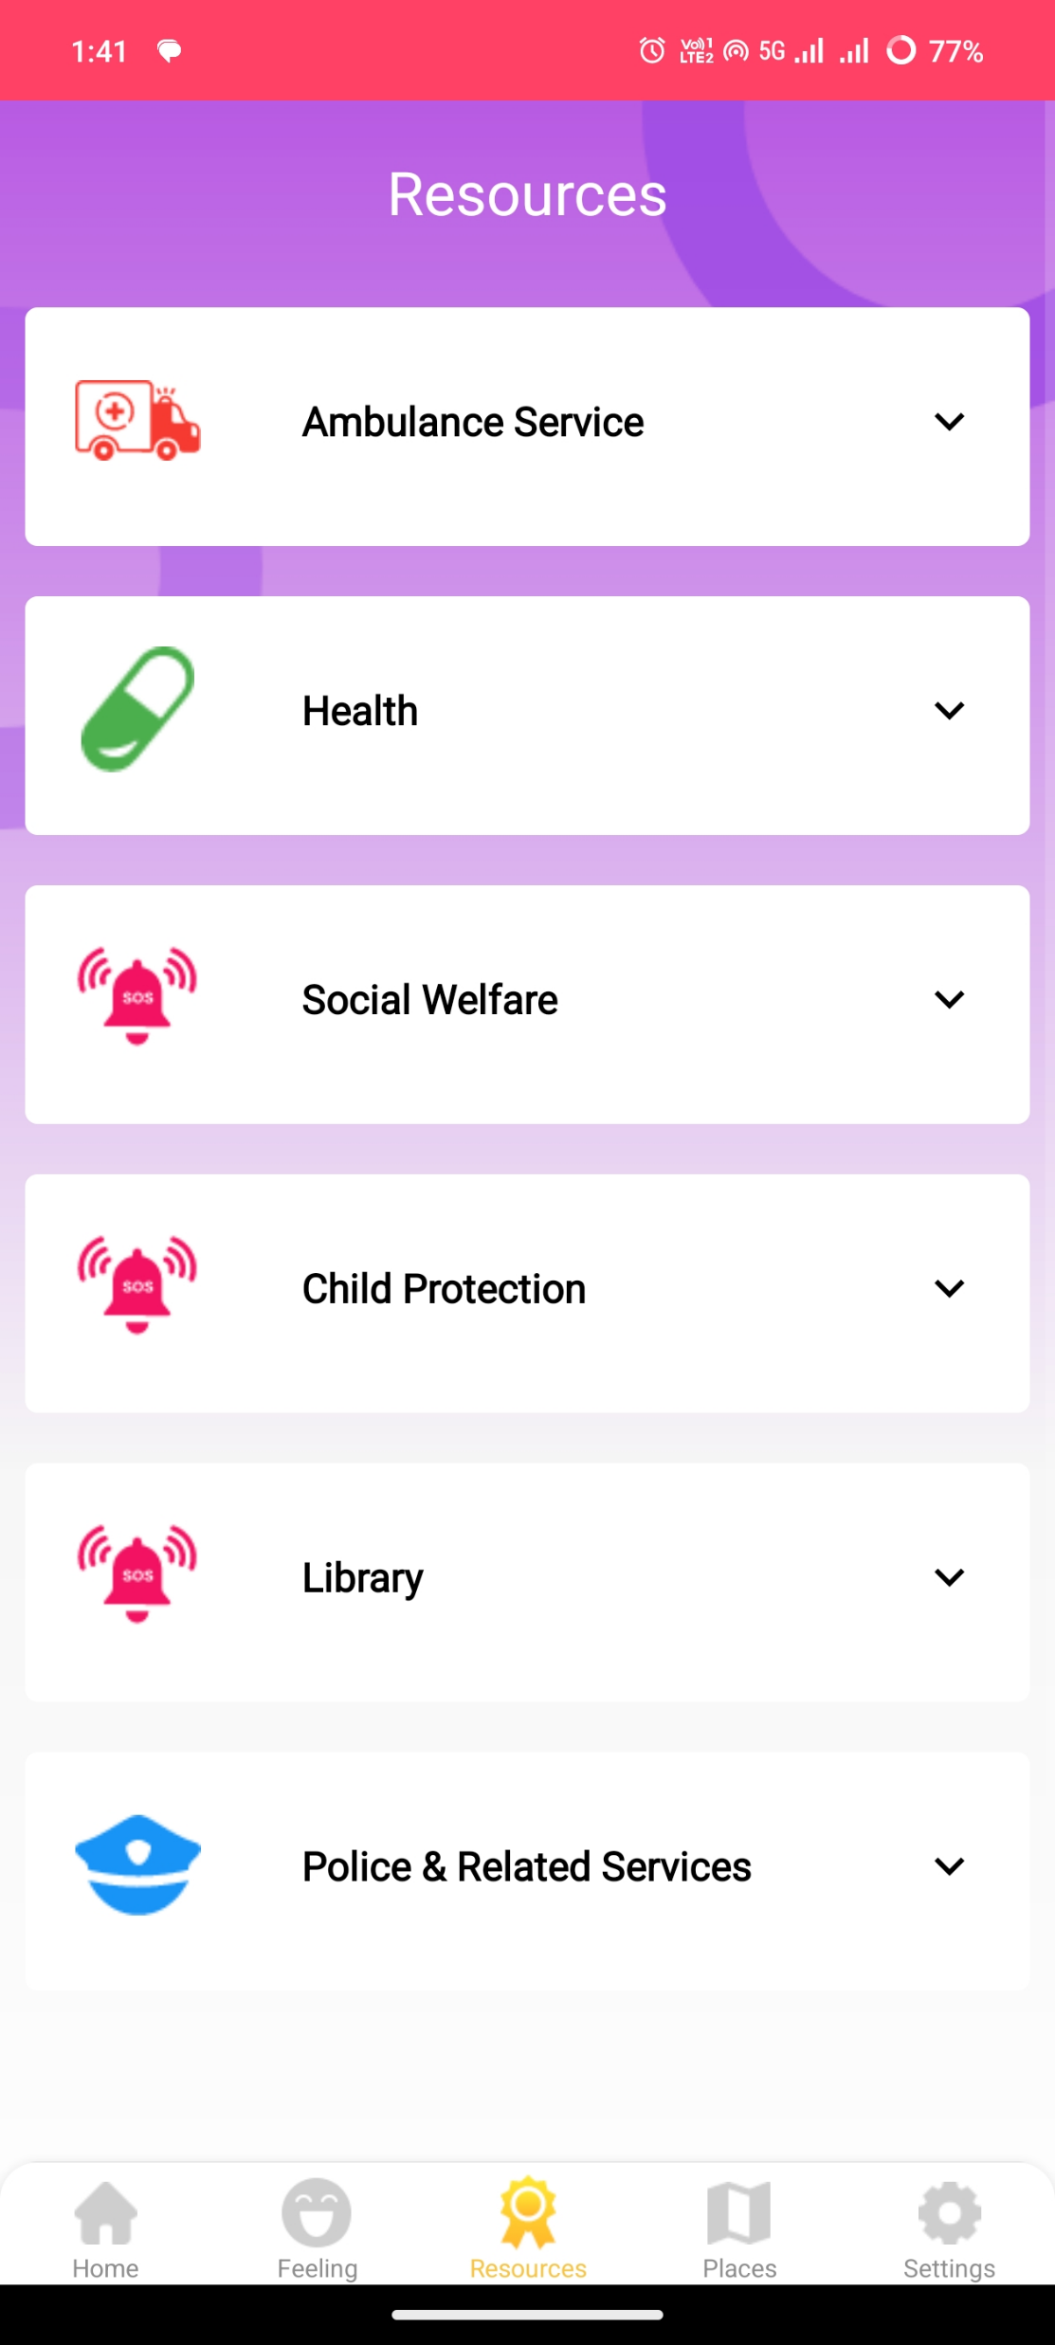
Home Page Enter the Login details
Click here to filter data by Disaster Type
Click here to navigate to the Data Analysis module
Perform following actions using the map toolbar:
Zoom-in
Zoom-out
Reset
Label on/off
North symbol show/hide
Click here to change the Visualization Type

Slide 26
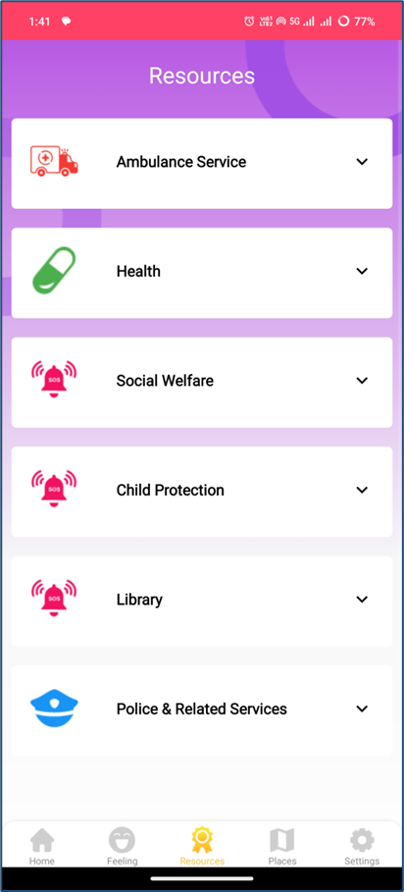
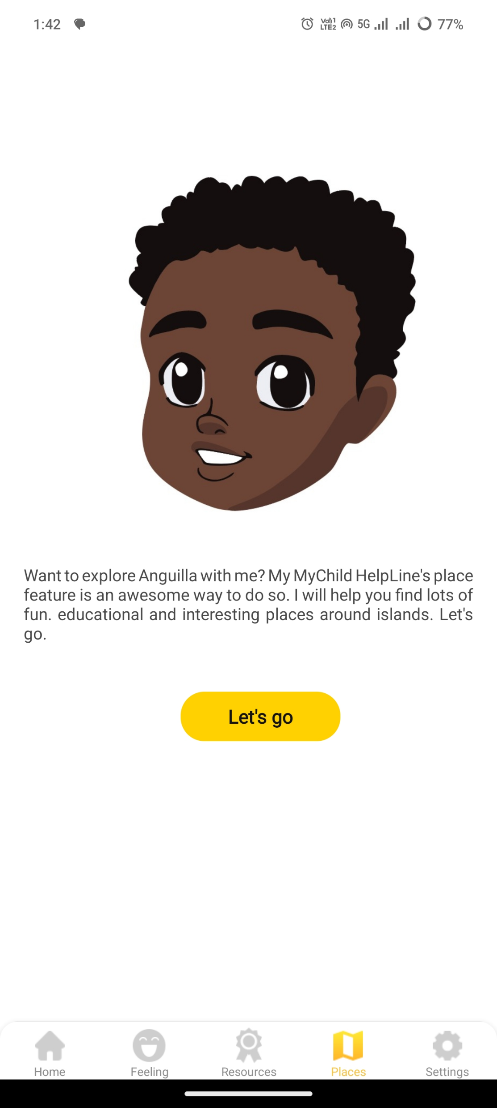
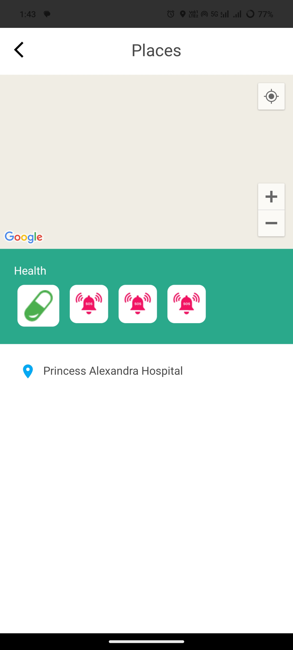
Home Page Enter the Login details
Click here to Submit or Delete the Finalized form respectively
Click here to Delete the sent form
Click here to Edit the saved forms
Click here to view the Finalized forms
Click here to view the Sent forms

Slide 27
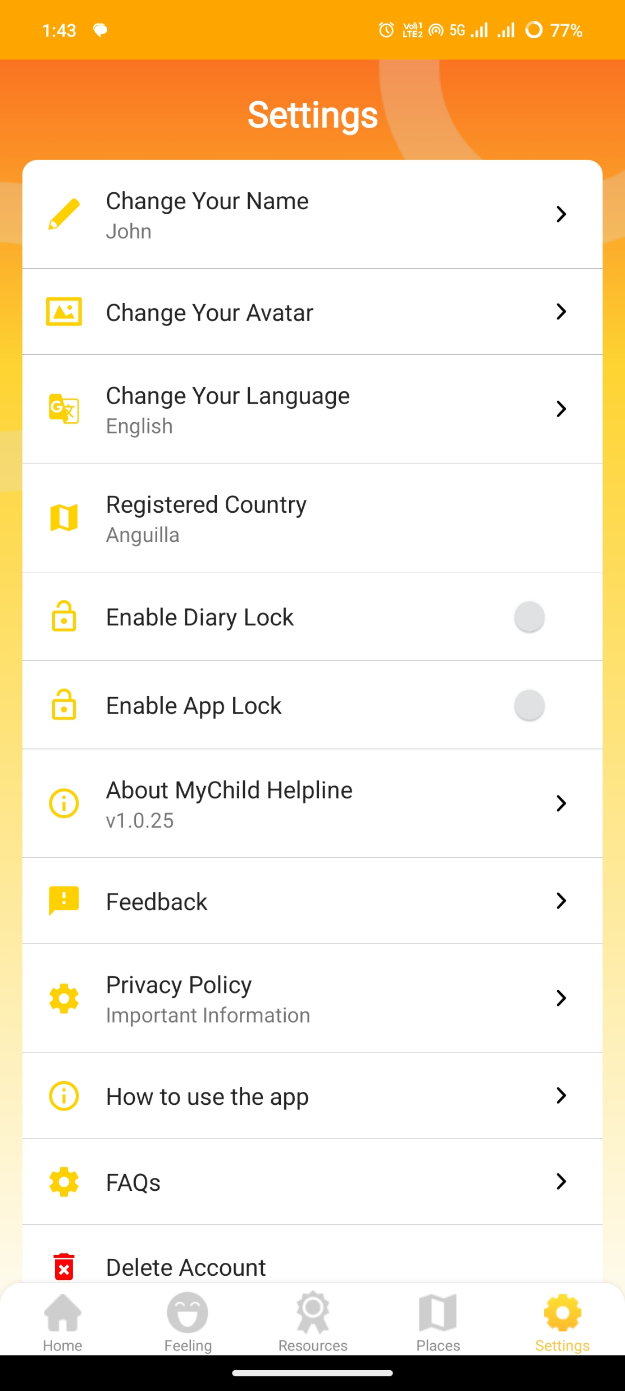
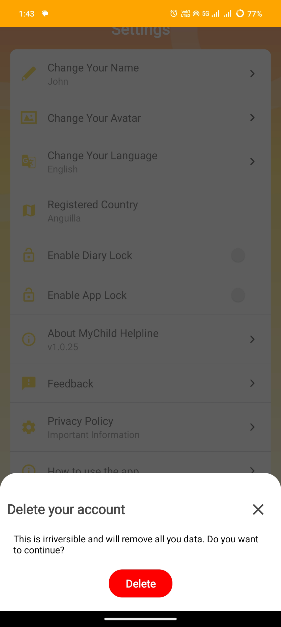
Home Page Enter the Login details
Homepage
Data Analysis
Click here to filter data by Disaster Type
Click here to navigate to the Data Analysis module
Perform following actions using the map toolbar:
Zoom-in
Zoom-out
Reset
Label on/off
North symbol show/hide
Click here to change the Visualization Type

Slide 28


